Slide 1
Illustration assets
The following pages contains approved Qiskit illustration visual assets that can be used during presentations.
If you would like to add an illustration to other slides, copy and paste the desired pattern from the following 4 slides on to your new slide.
Please maintain ratios of the images as shown in the following pages.
The sizes of the images can be changed to fit your needs, but generally keep the large images larger than the small images.
Image captions are optional

Slide 2
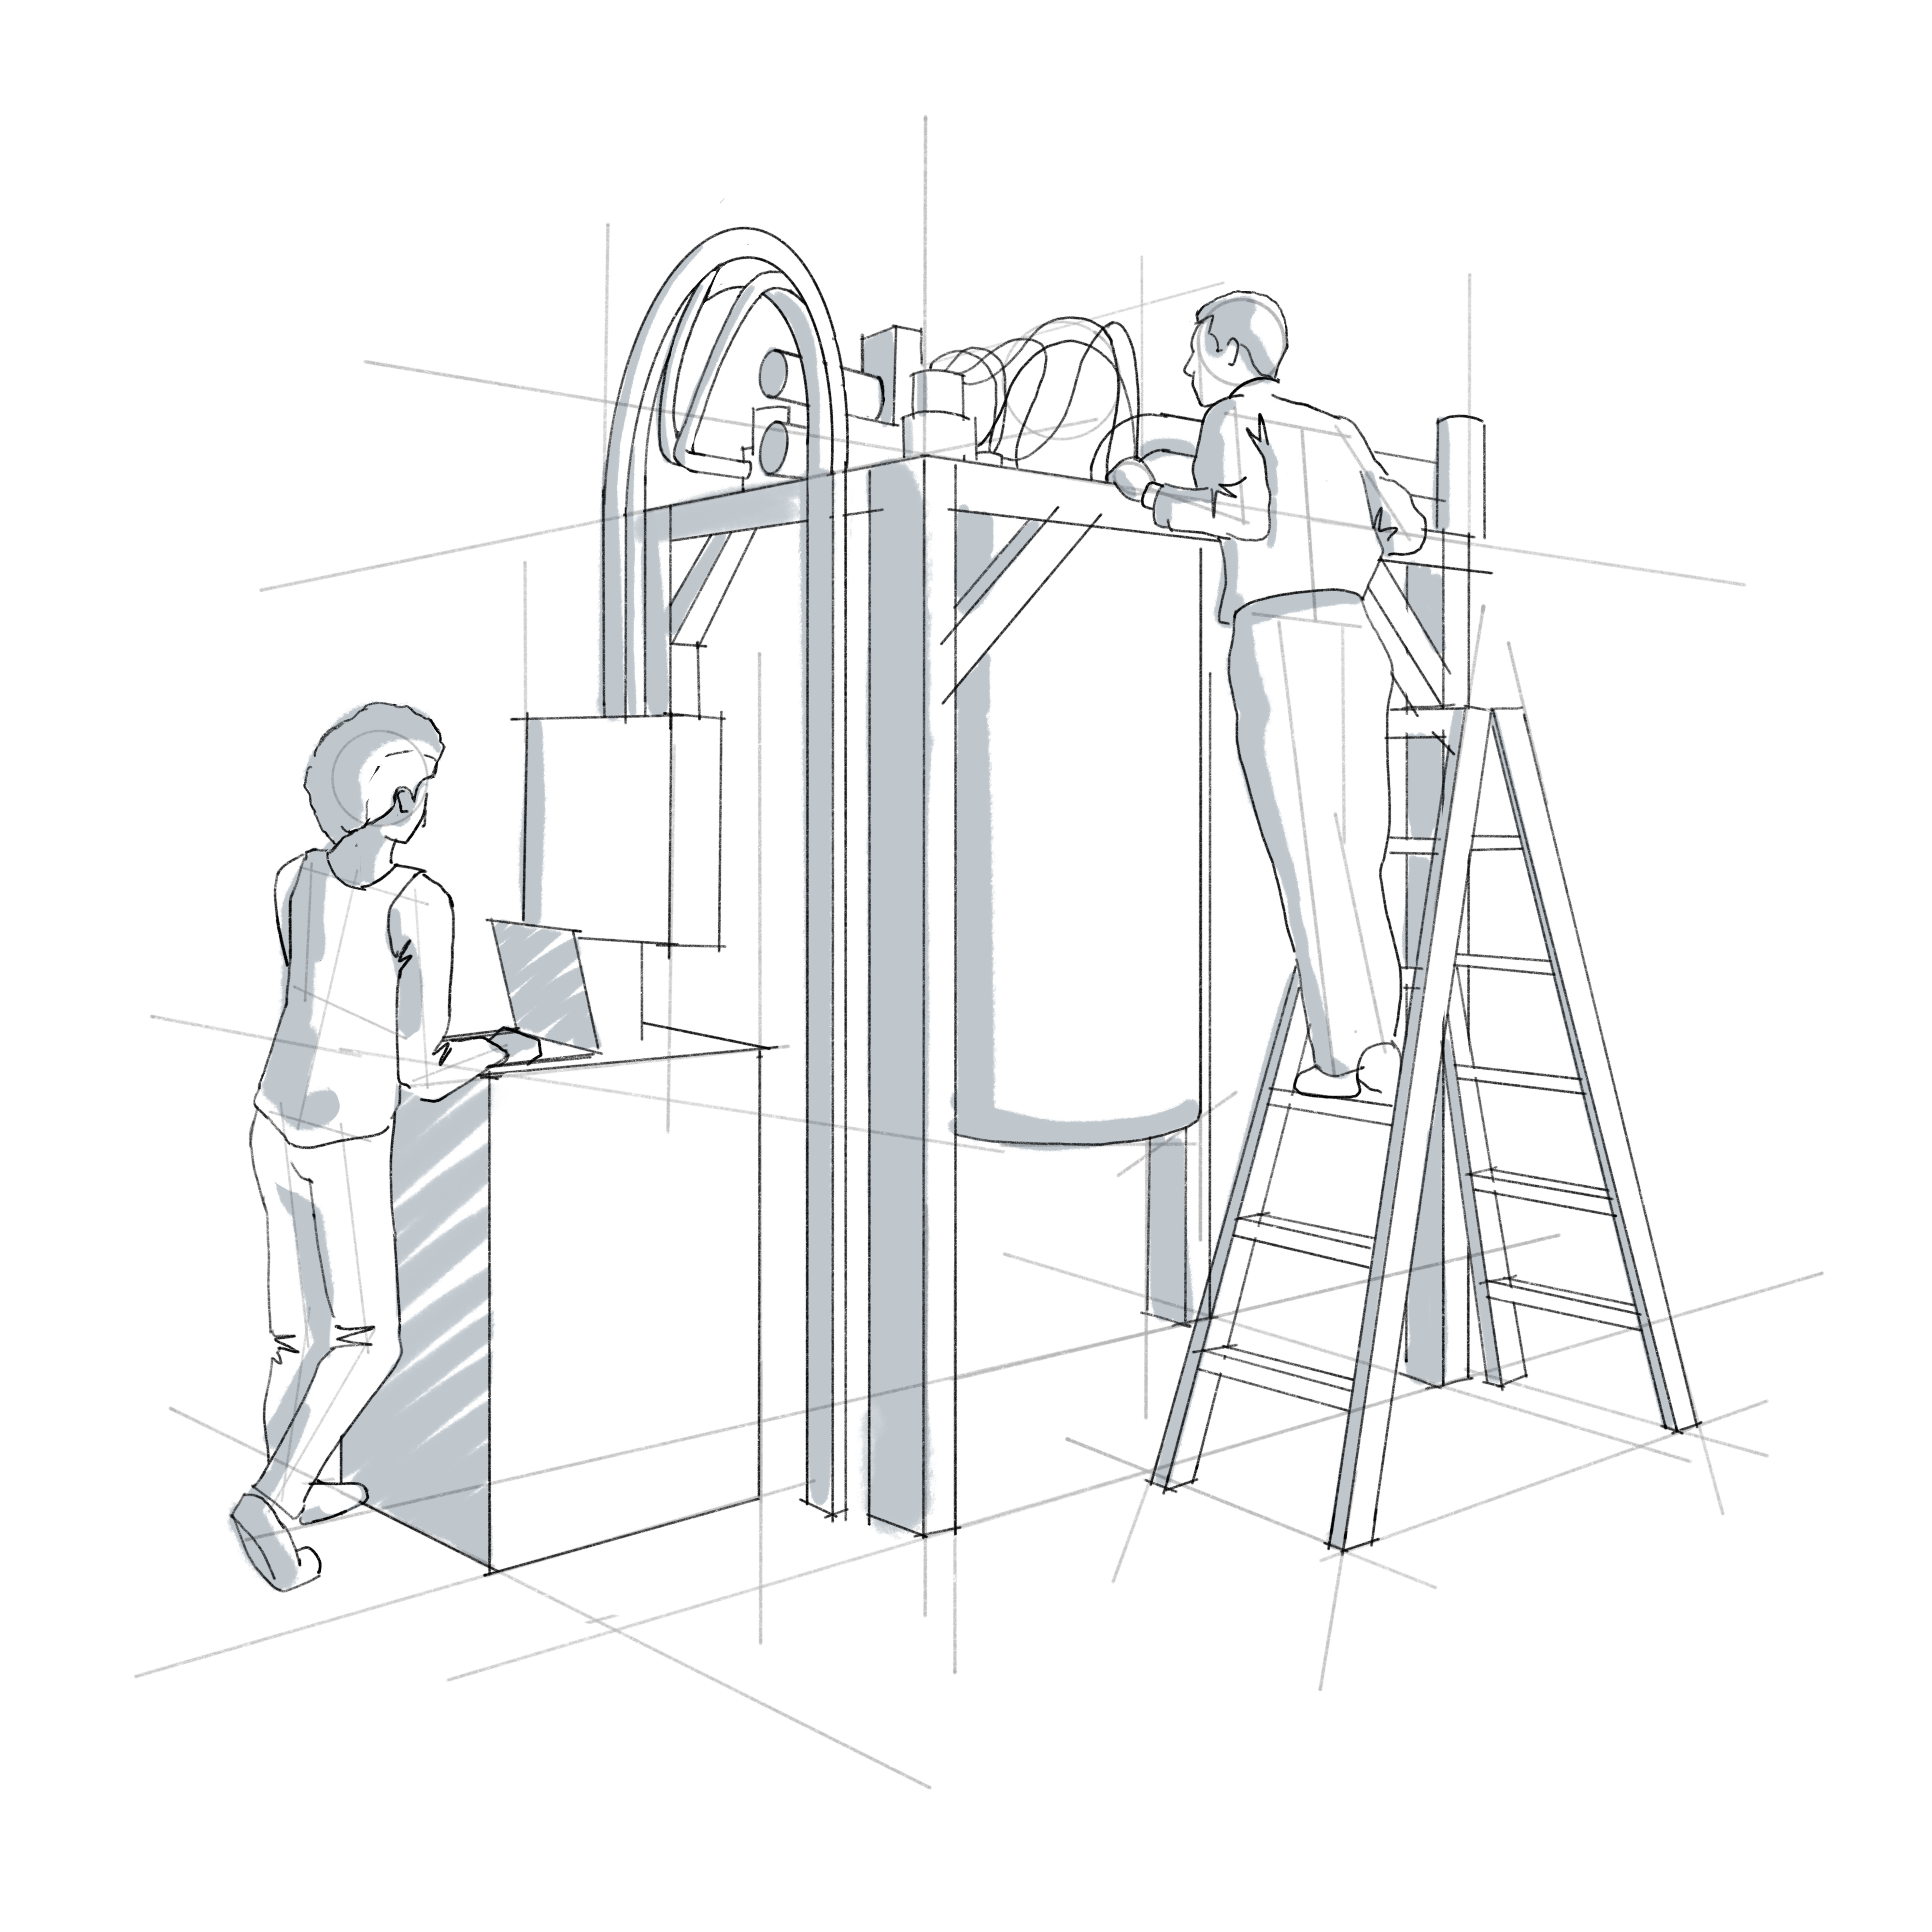
Hero image 1
Two individuals working on a quantum computer

Slide 3
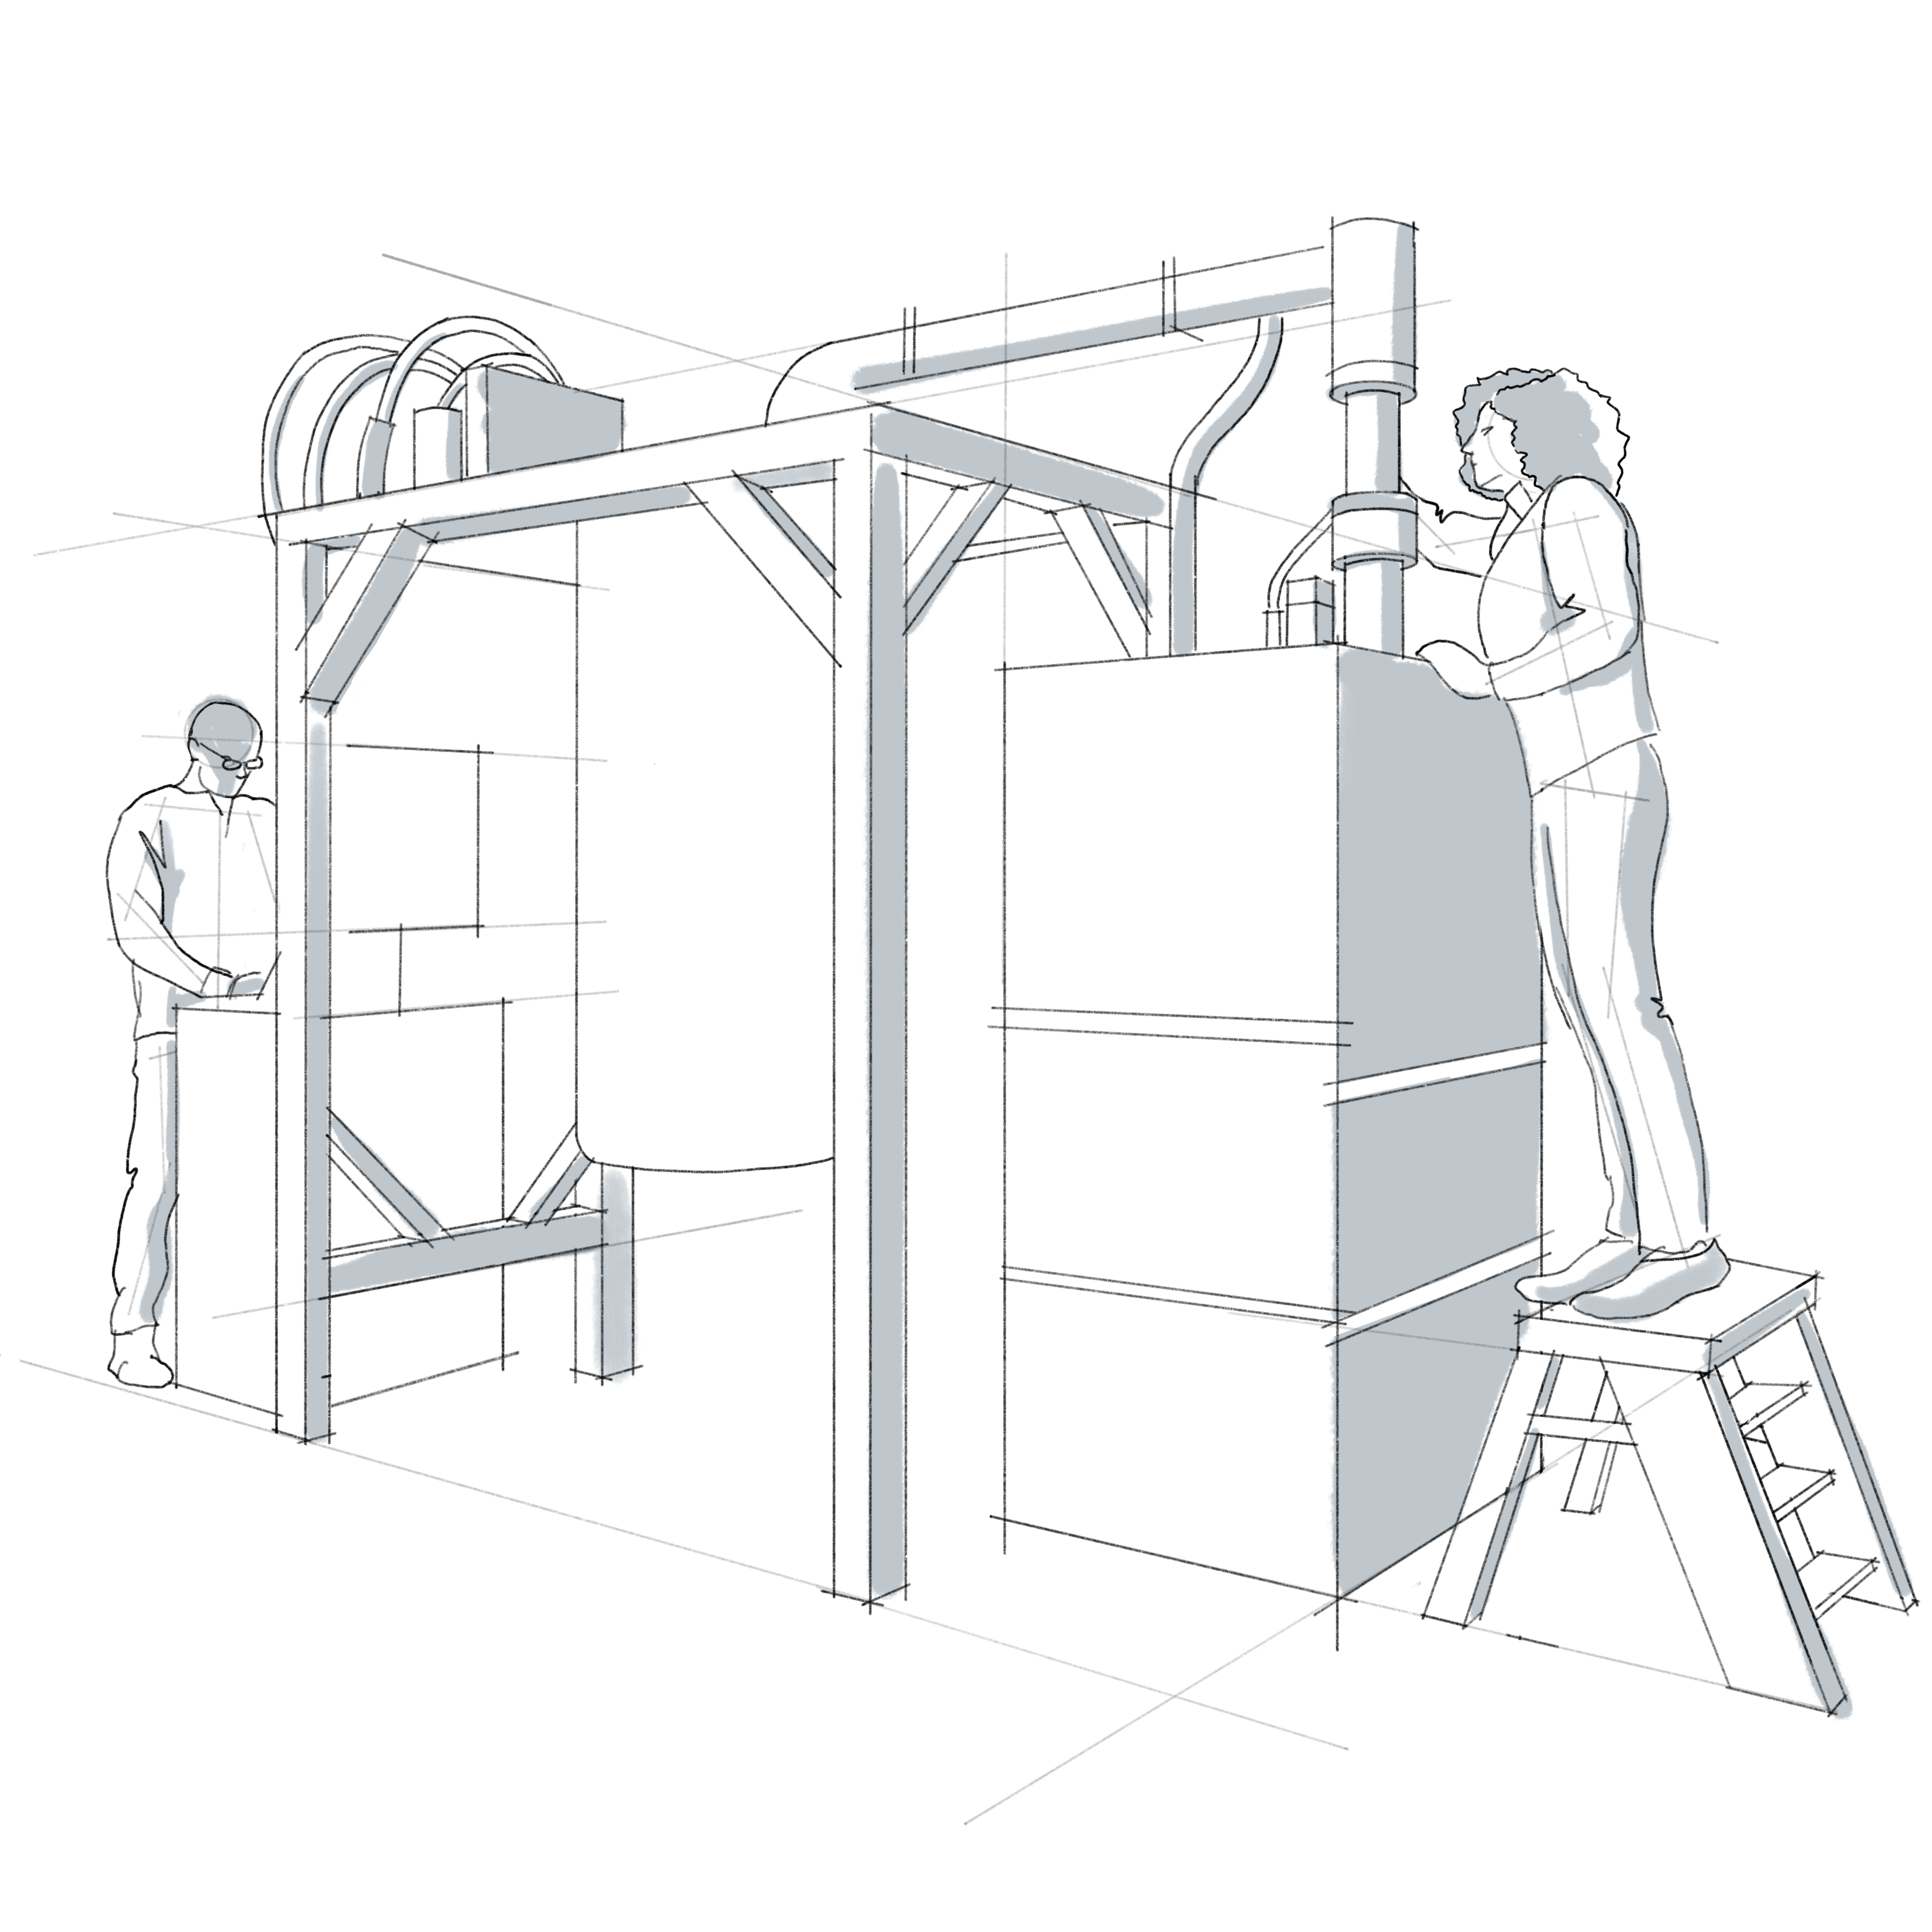
Hero image 2
Two individuals working on a quantum computer

Slide 4
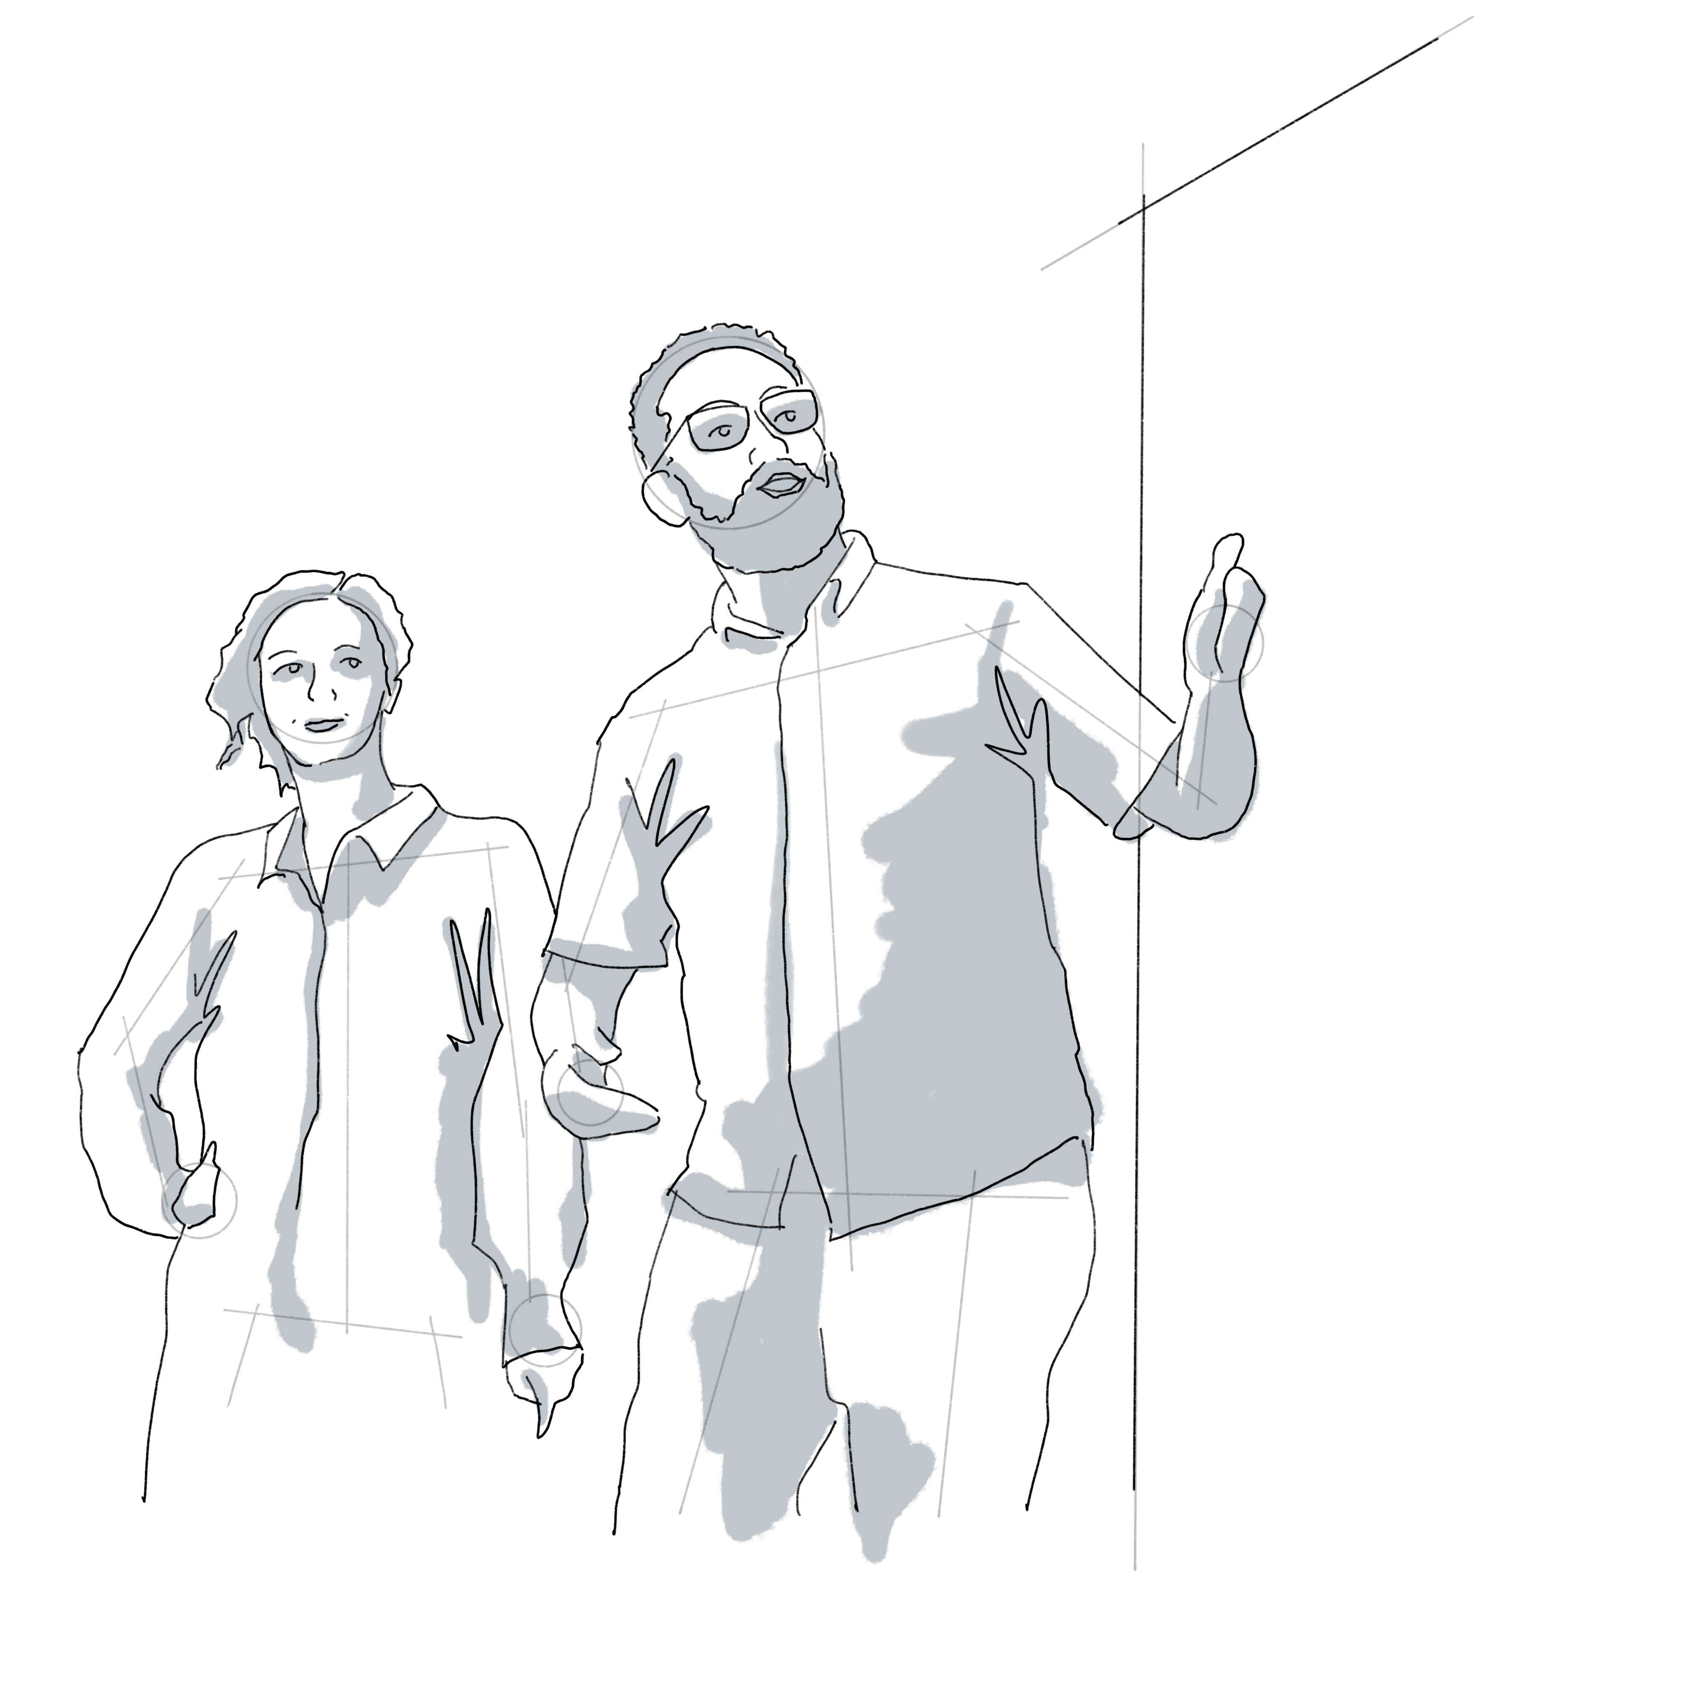
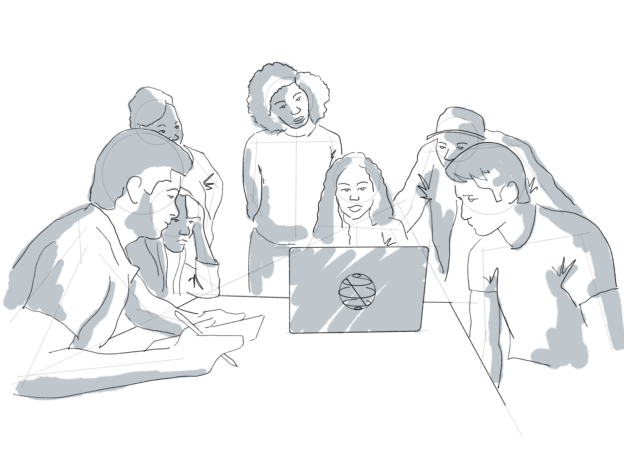
Large images 1
A group working with Qiskit
Two individuals teaching

Slide 5
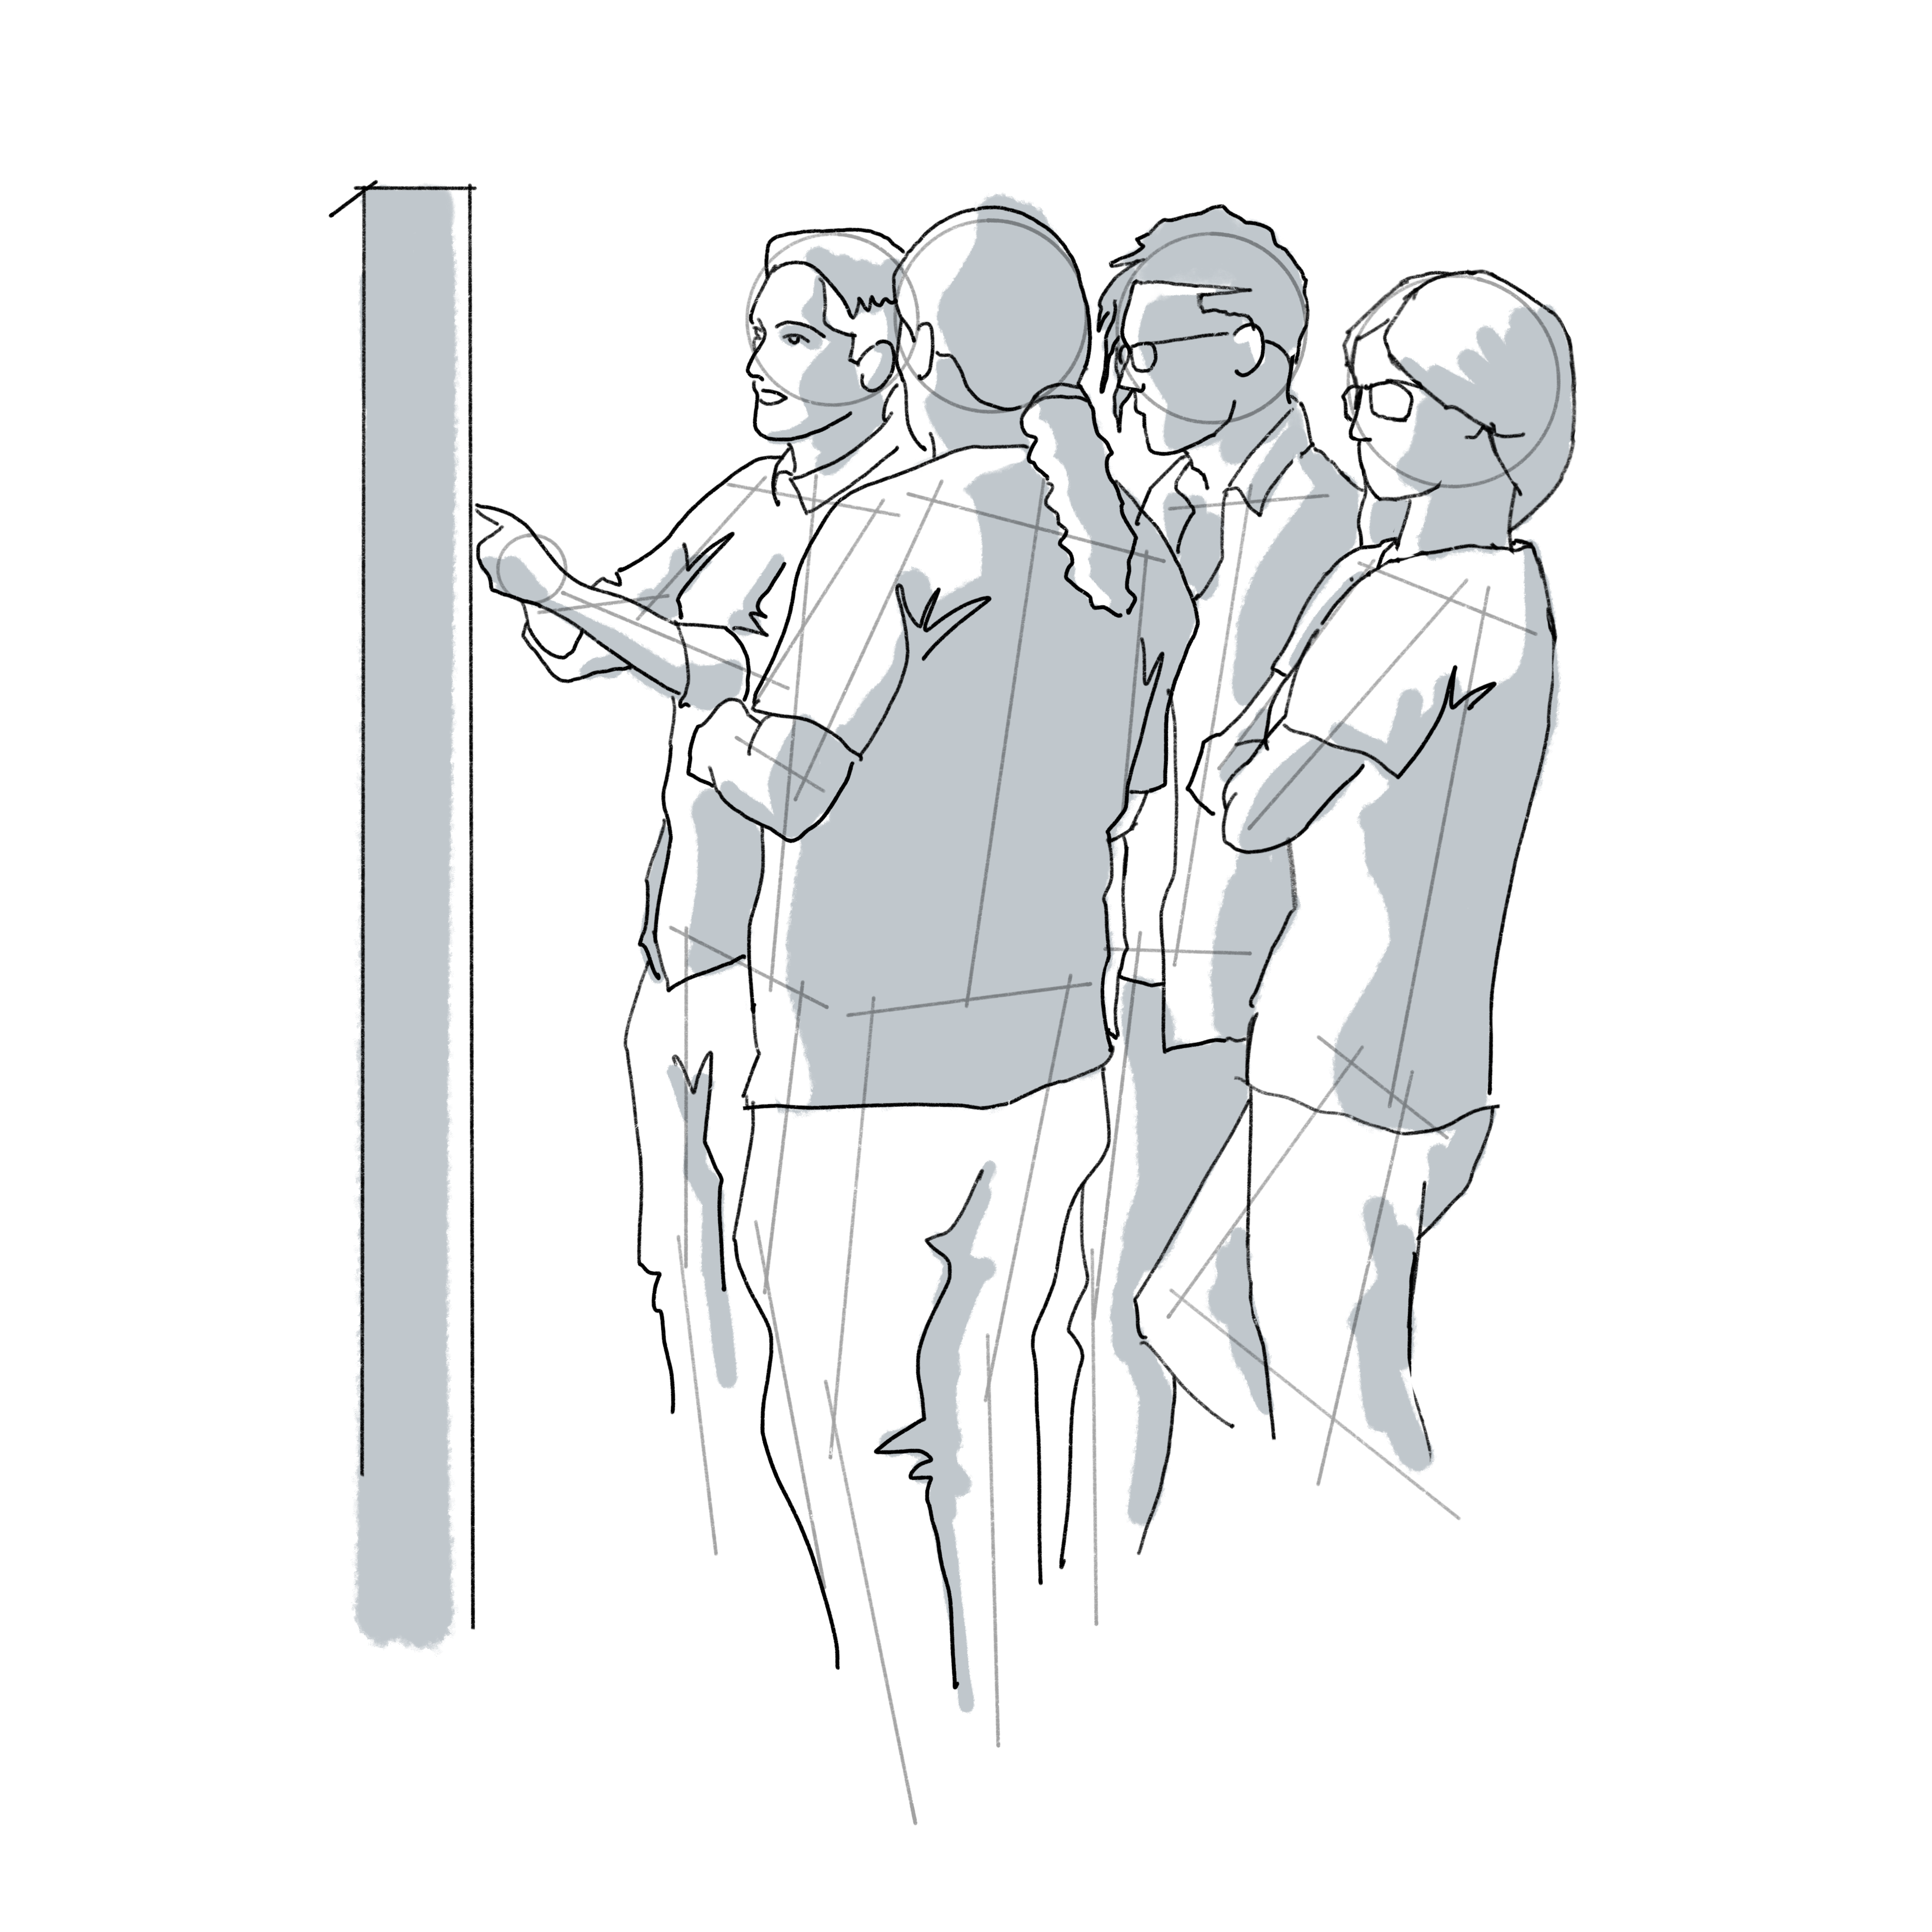
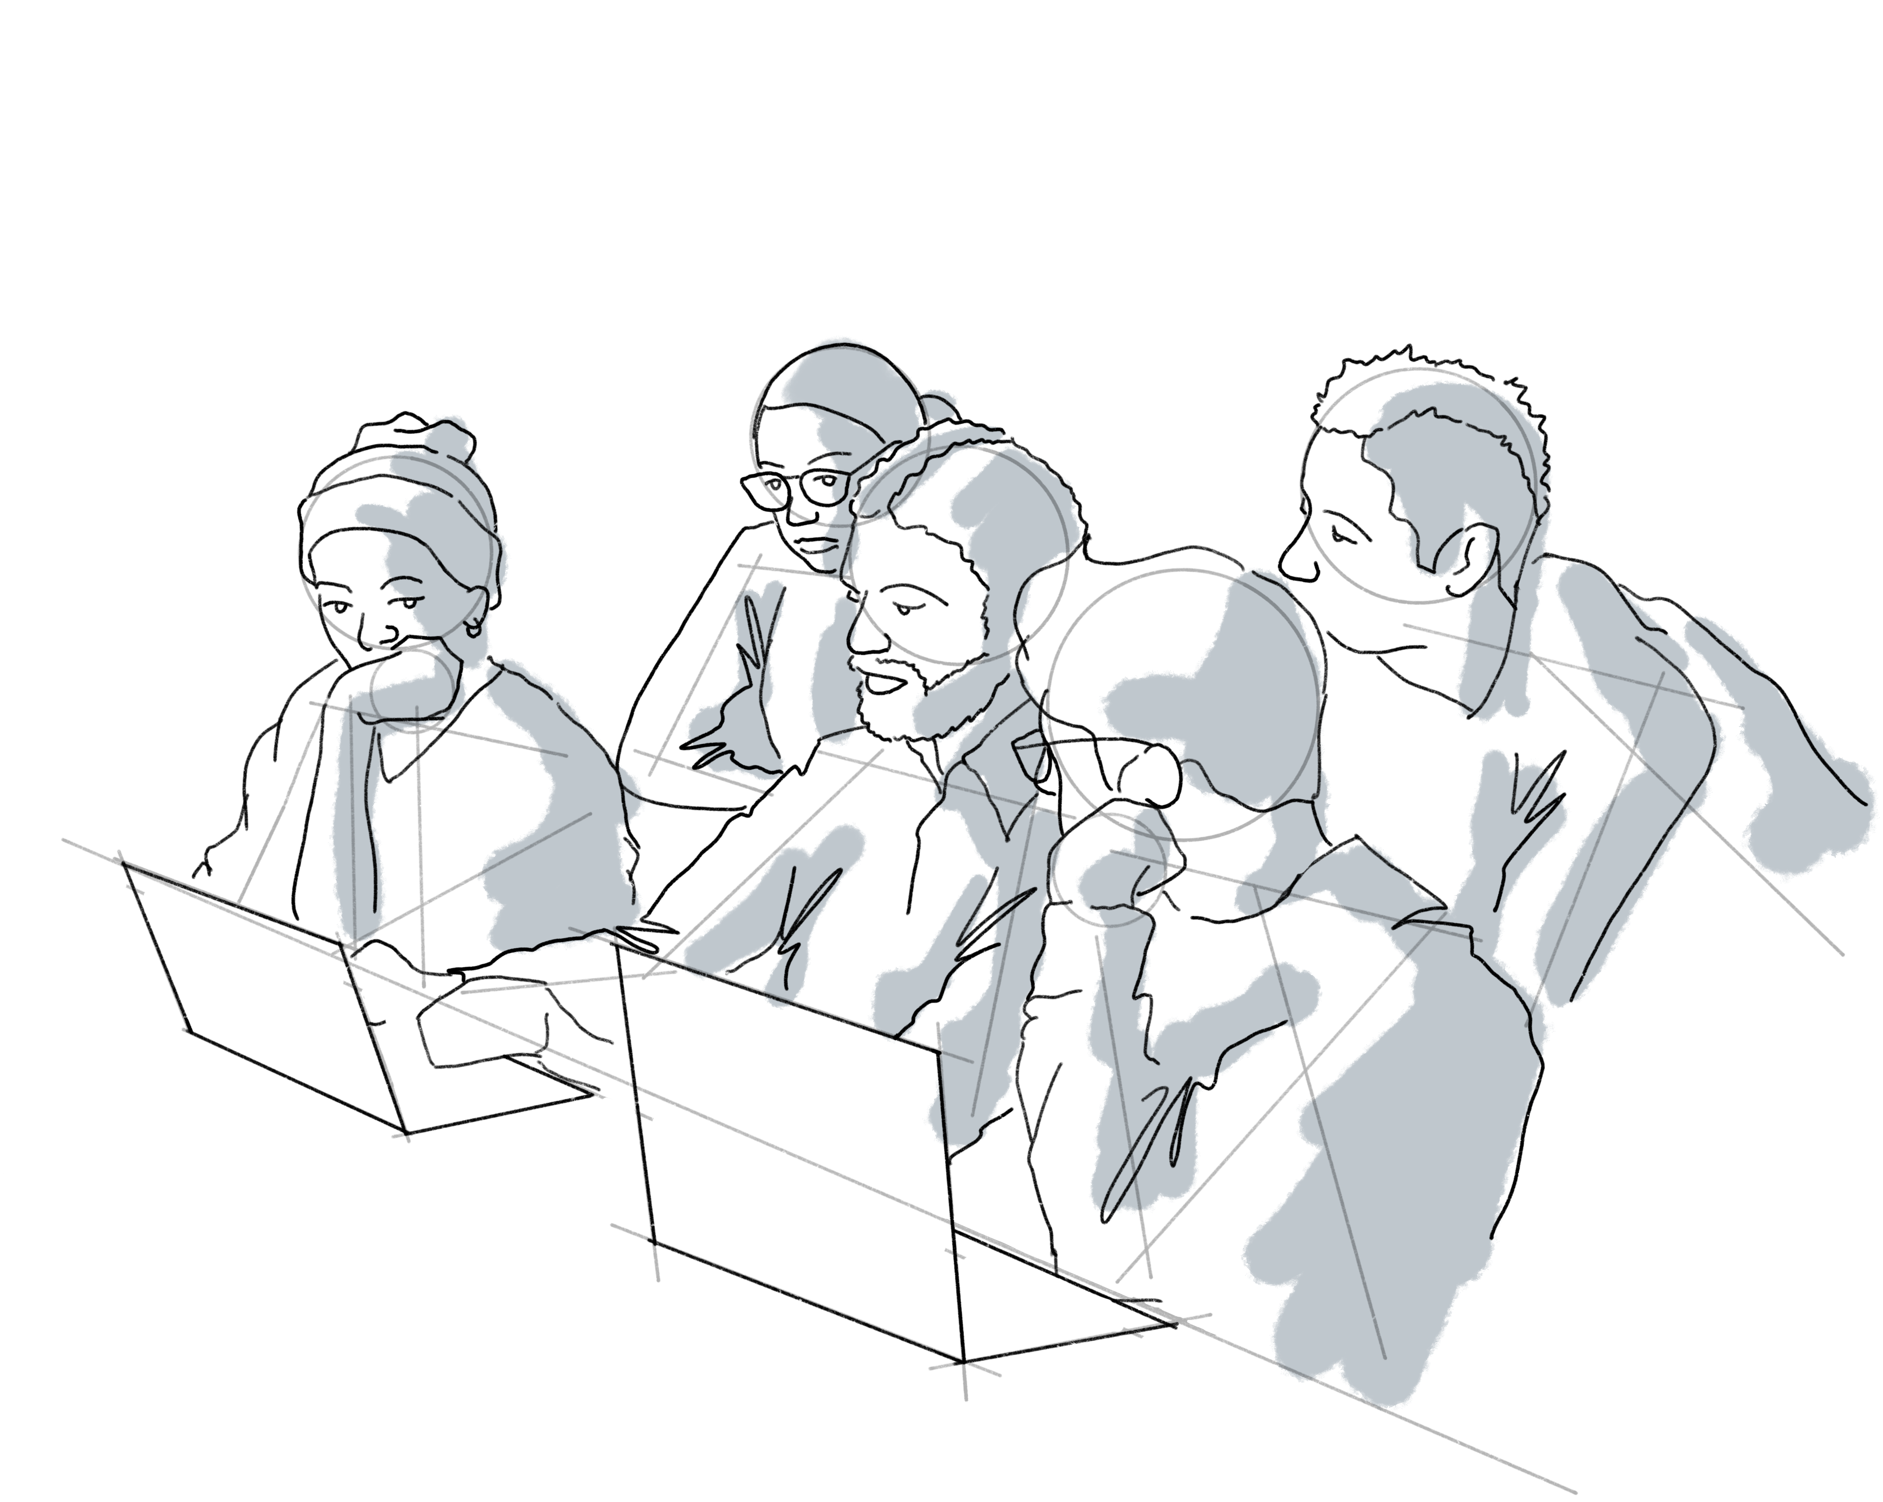
Large images 2
A group working with Qiskit
A group working on a white board

Slide 6
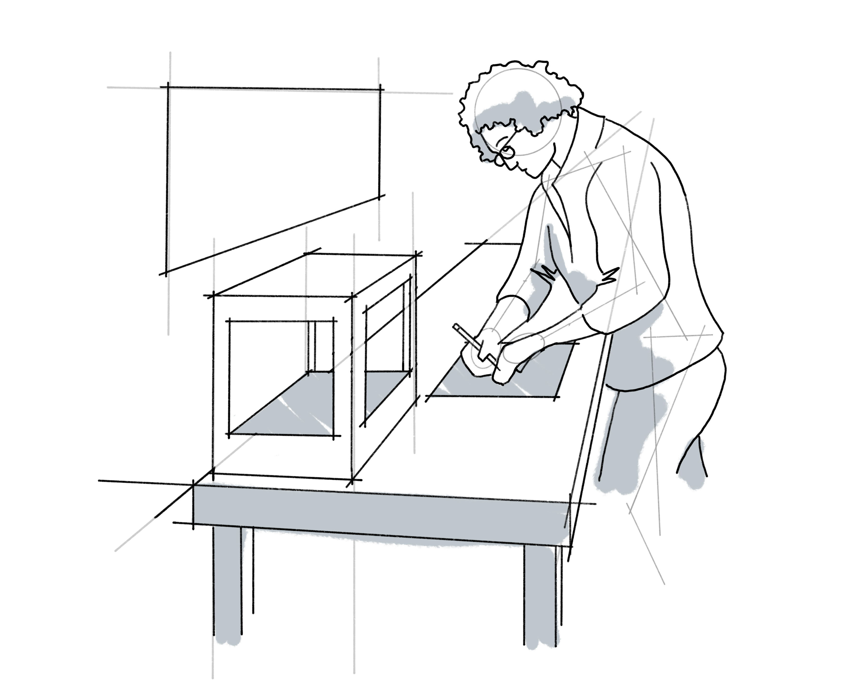
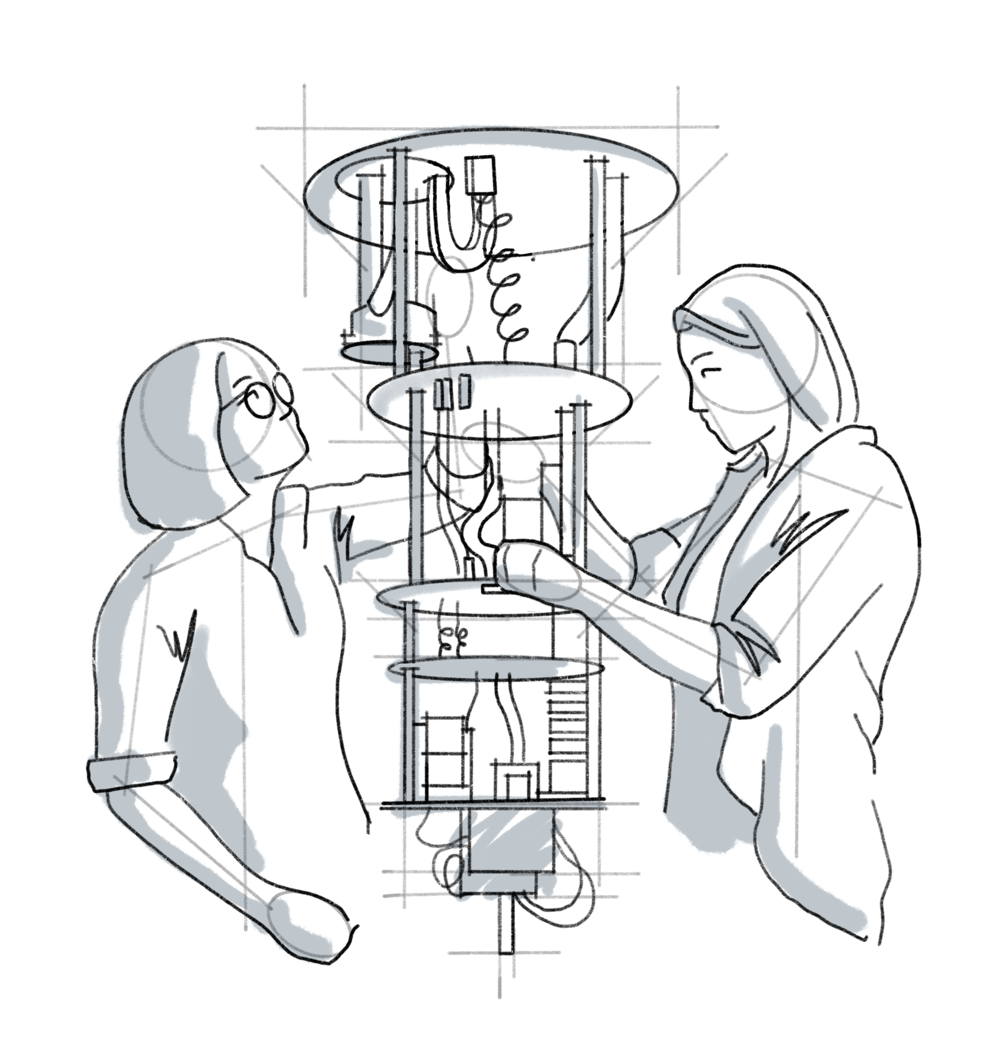
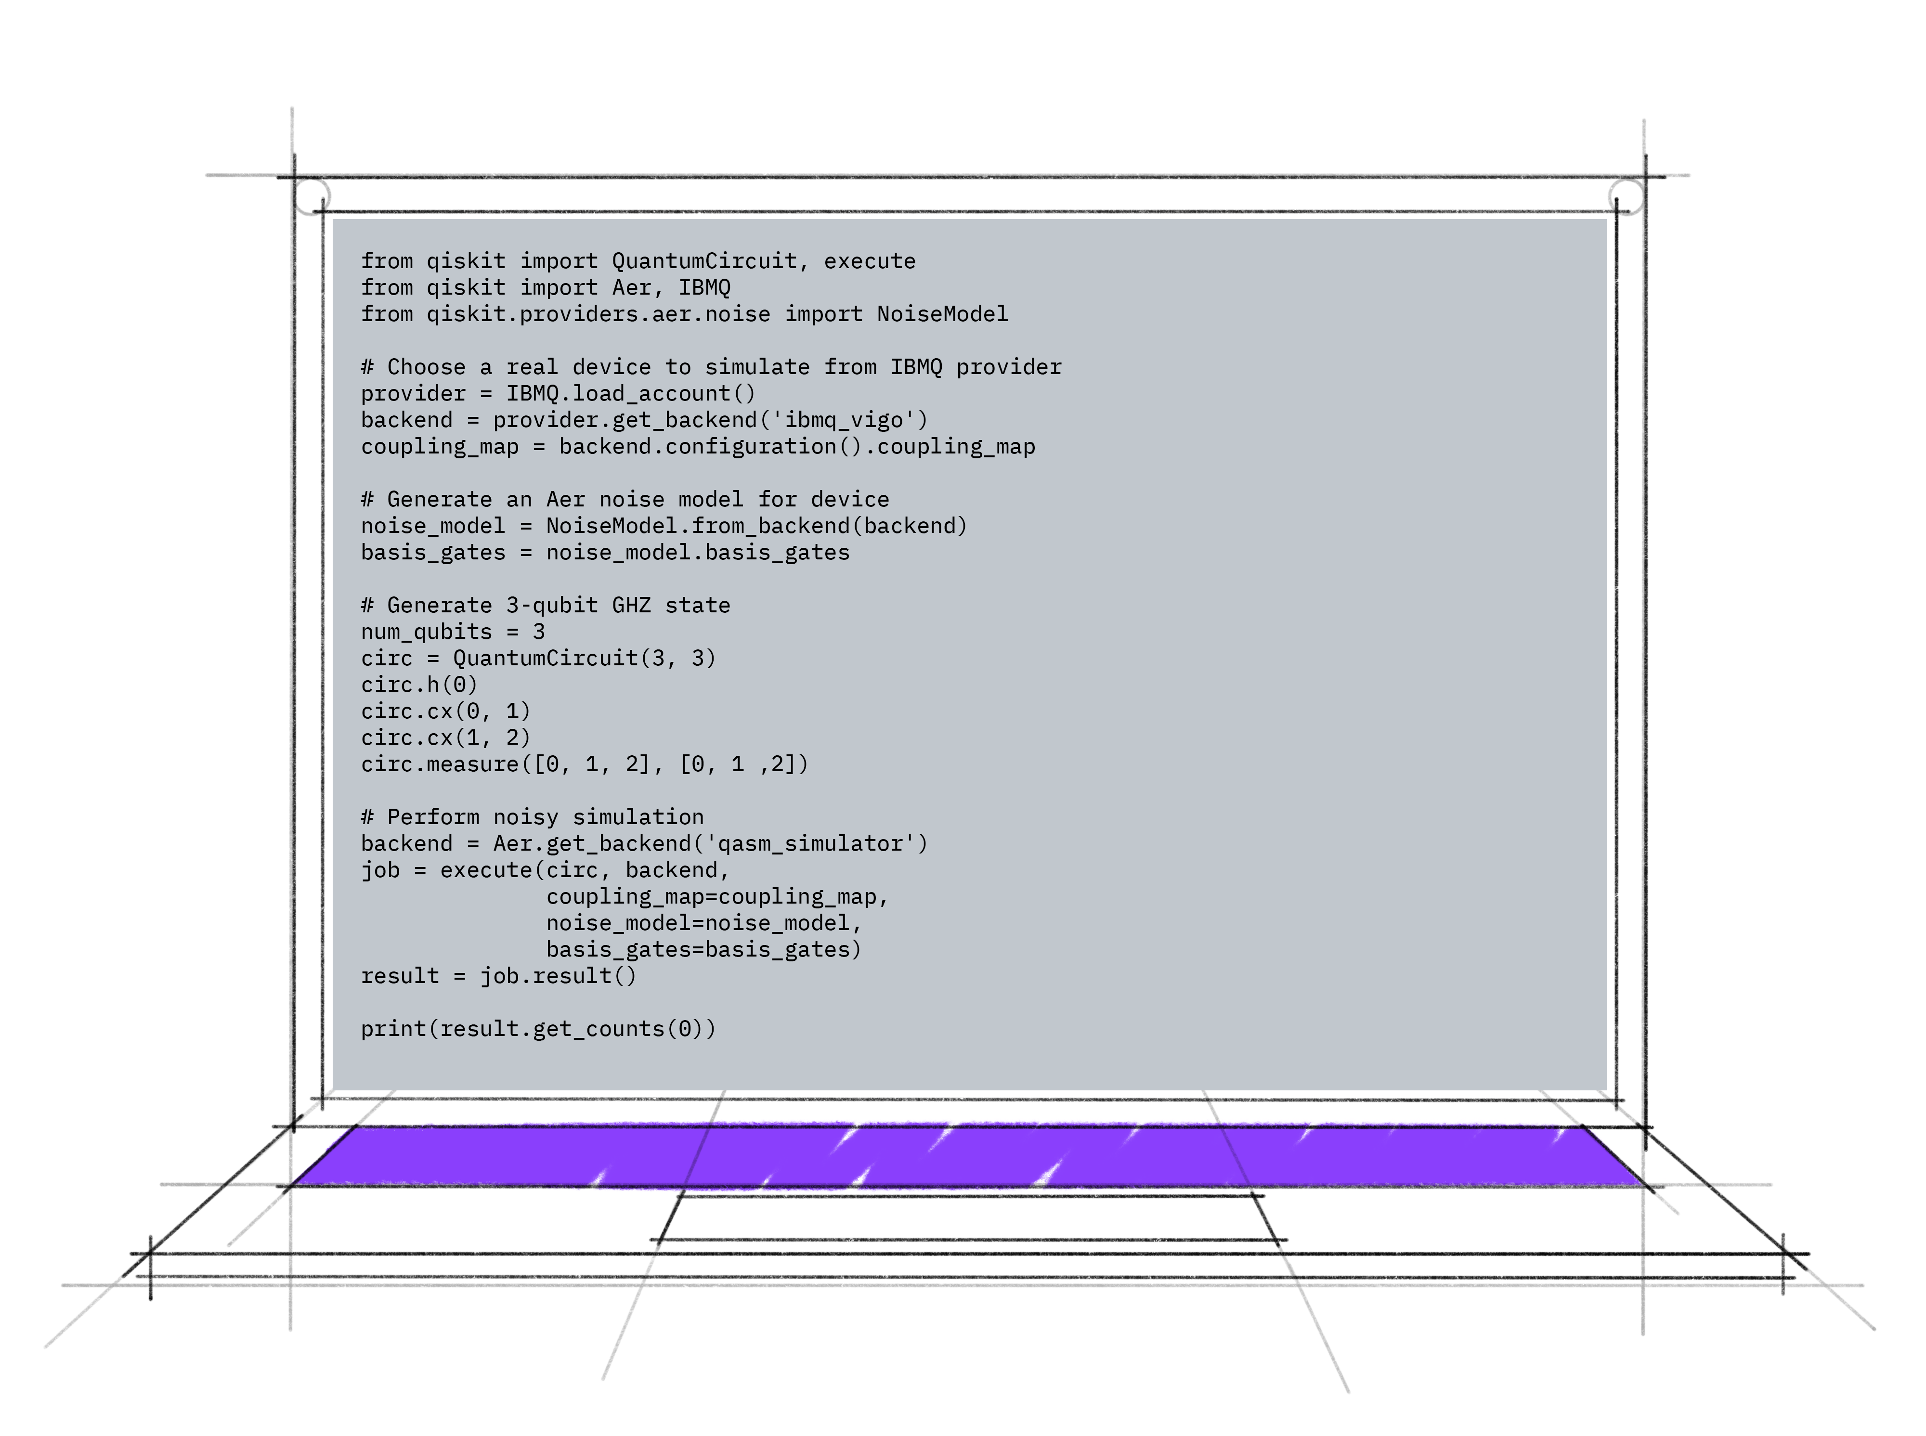
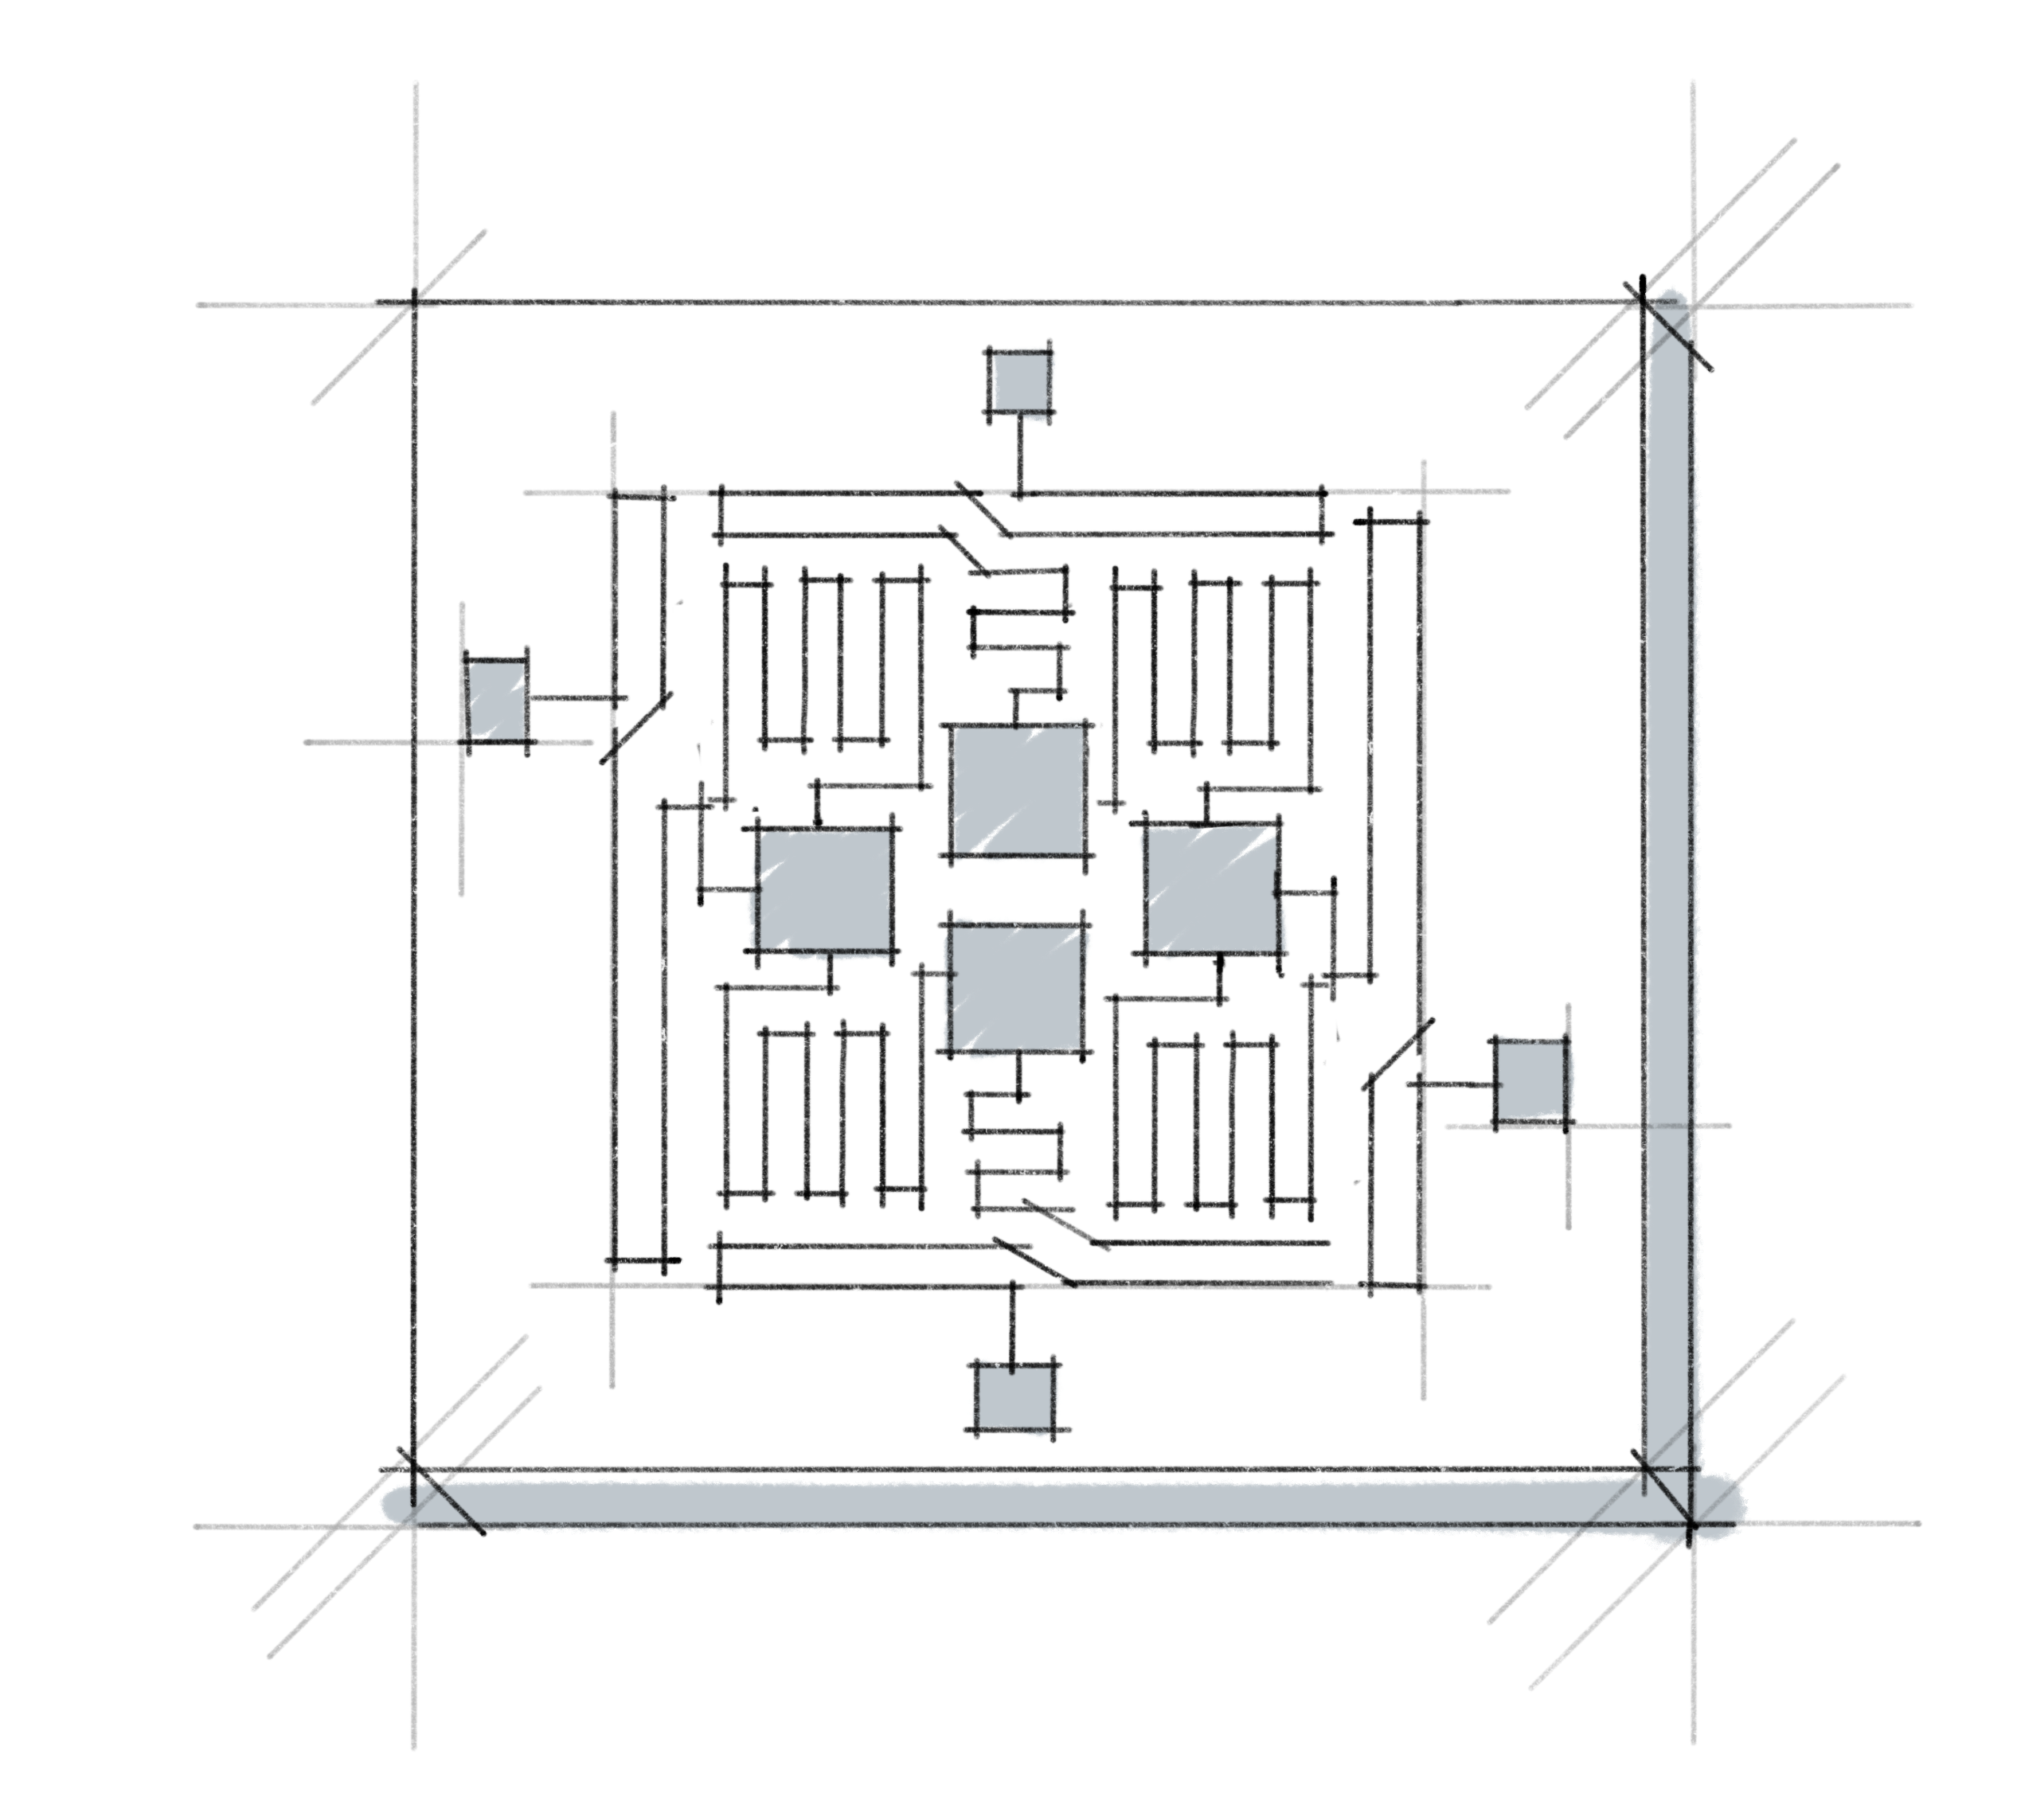
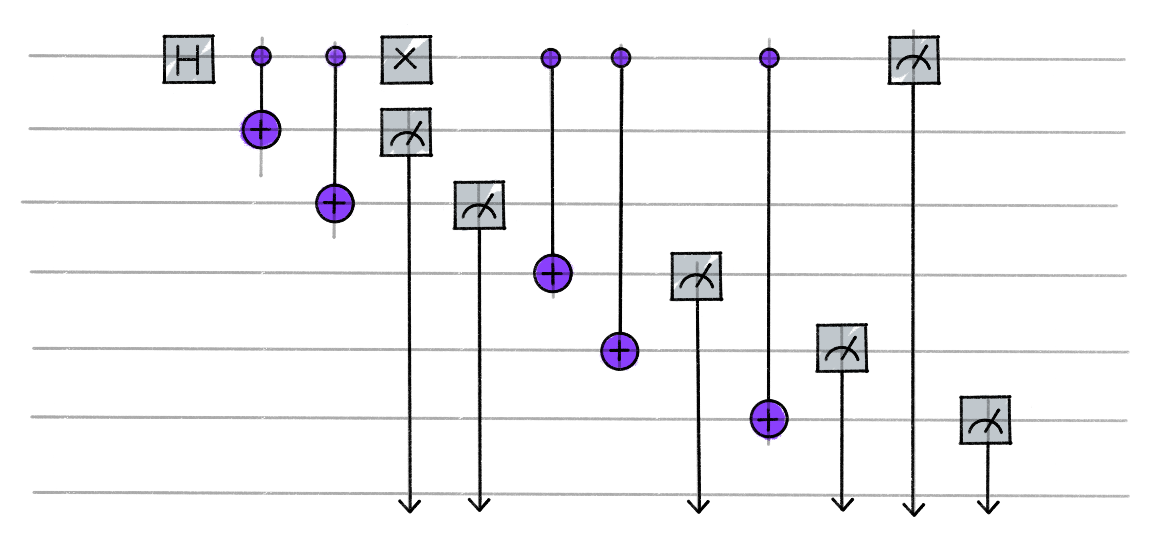
Medium images
Laptop showing Qiskit code
An individual working at a worktable
Two individuals working on a quantum computer
A Quantum circuit
A Quantum processing chip

Slide 7
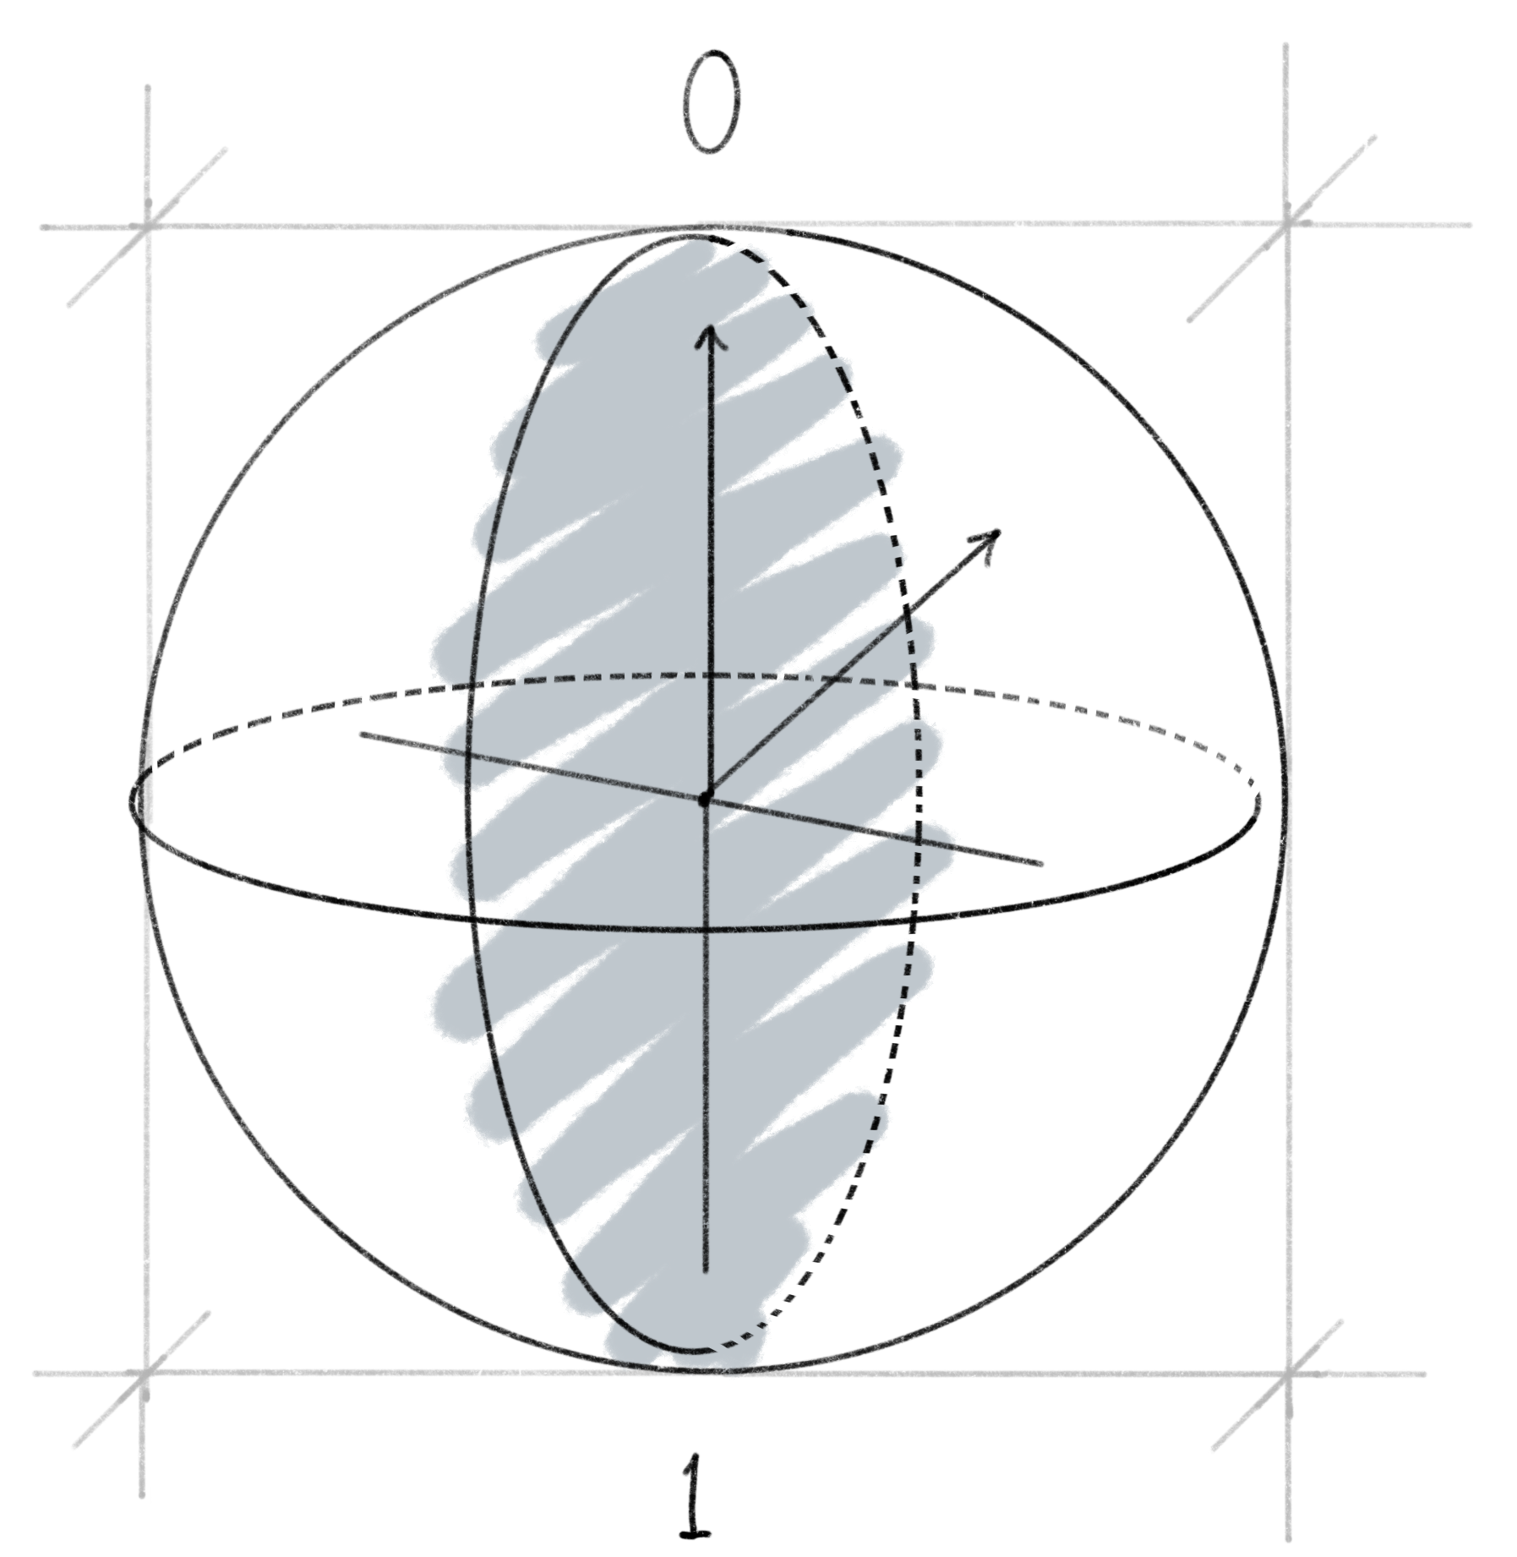
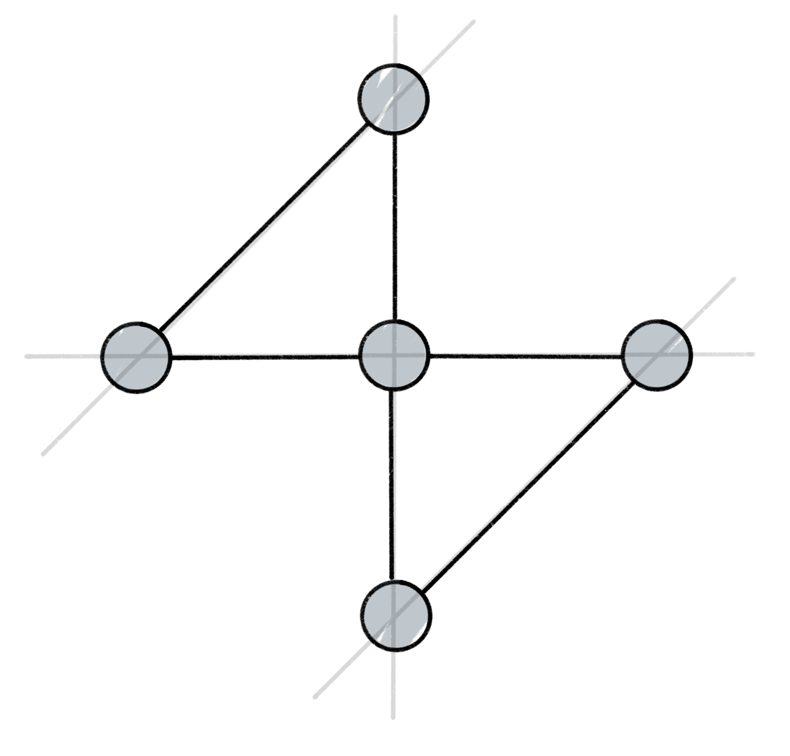
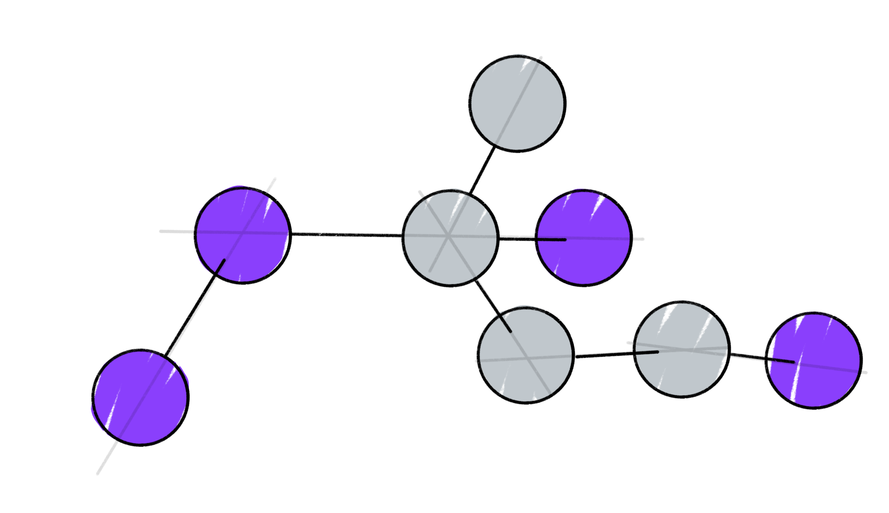
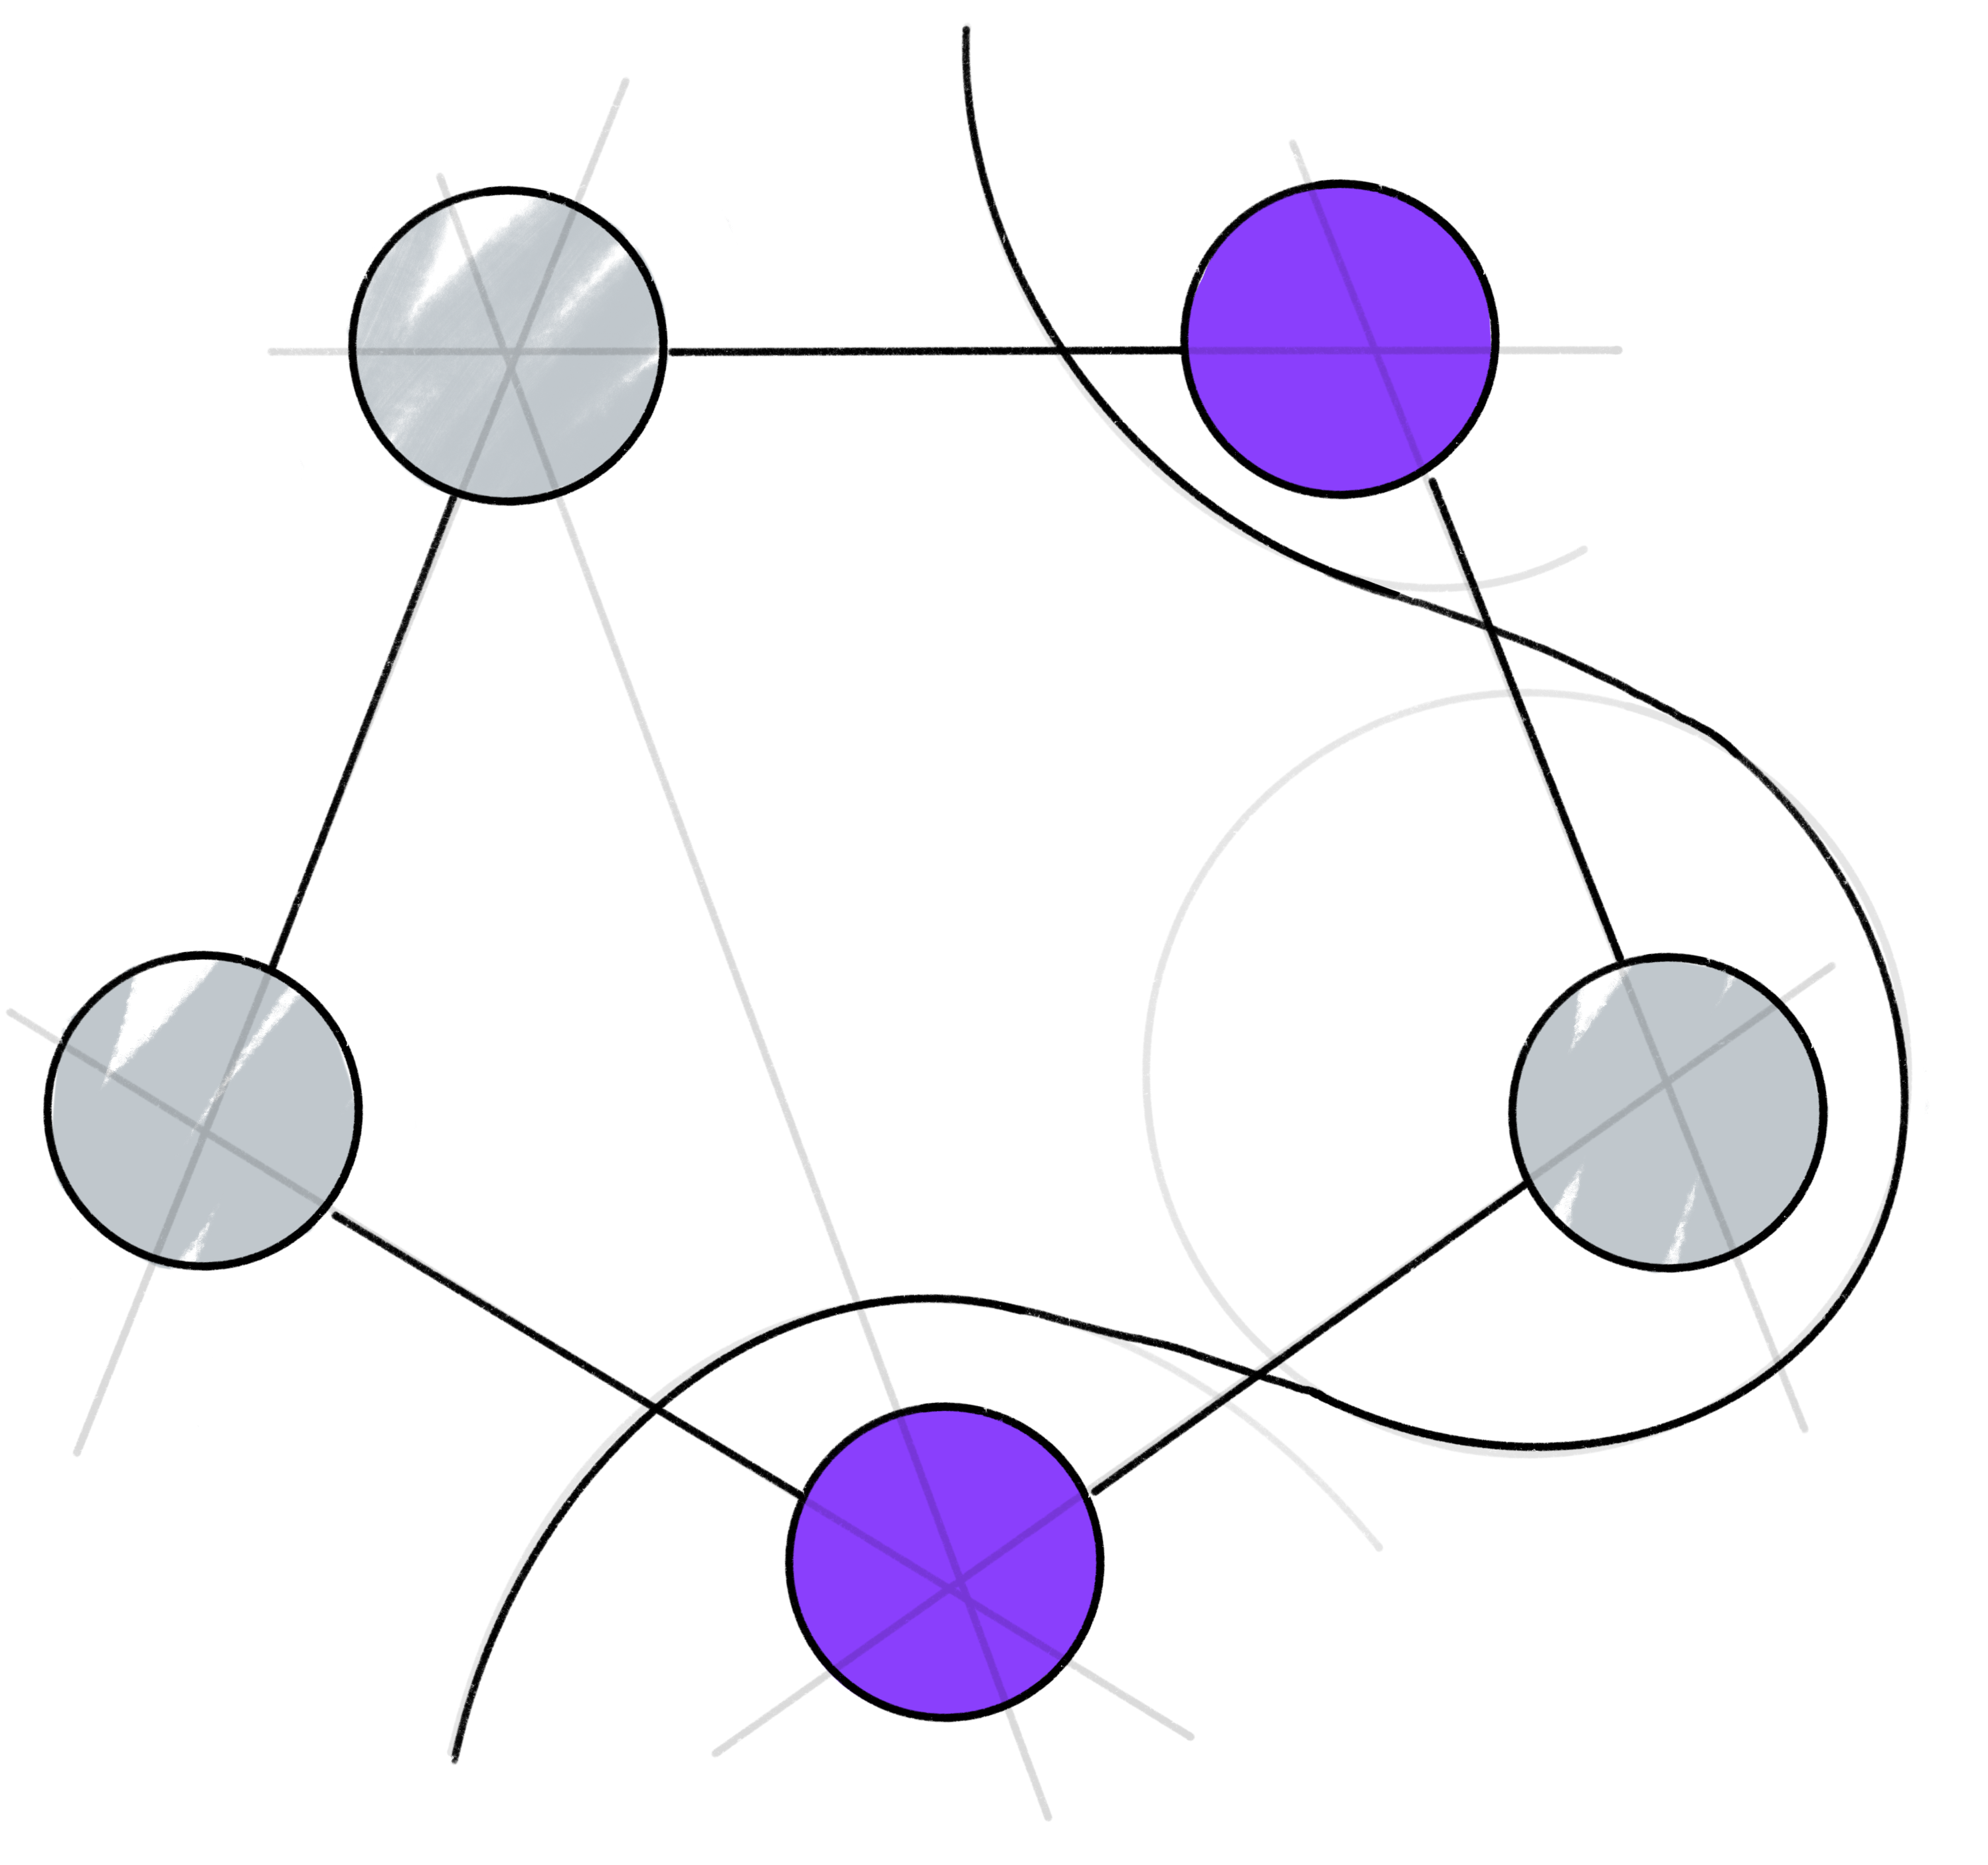
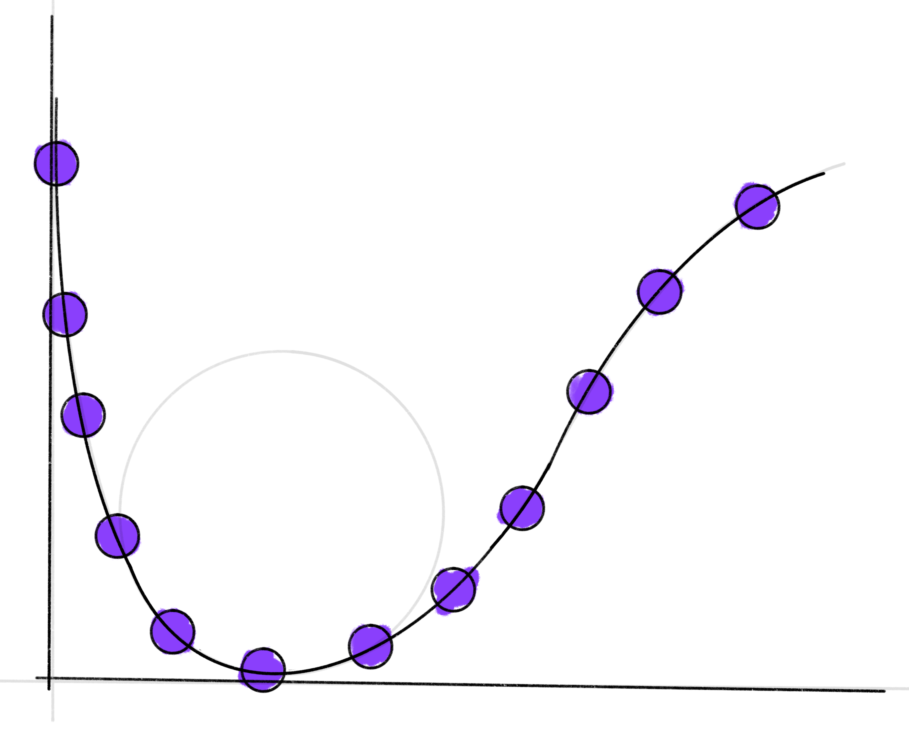
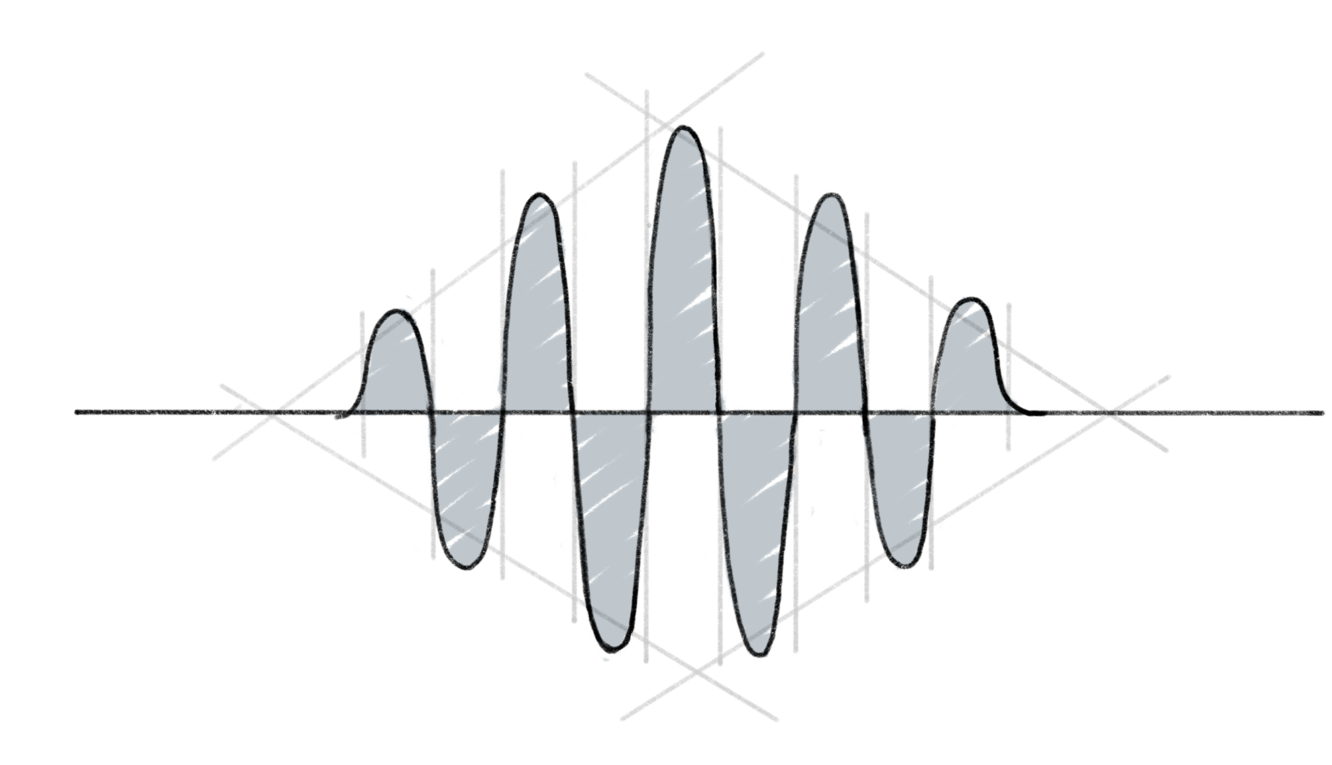
Small images 1
Topology diagram
Molecule visualization
Bloch Sphere
Max cut visualization
VQE visualization
Amplitude visualization

Slide 8
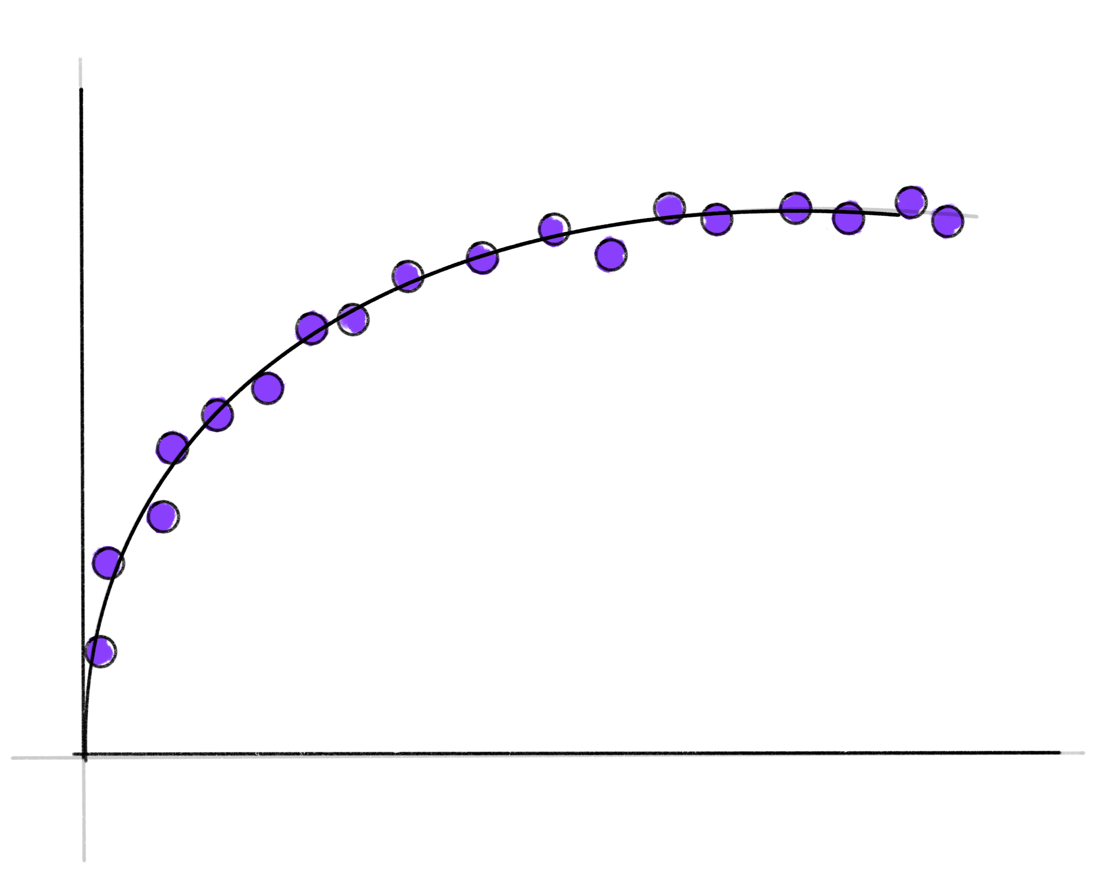
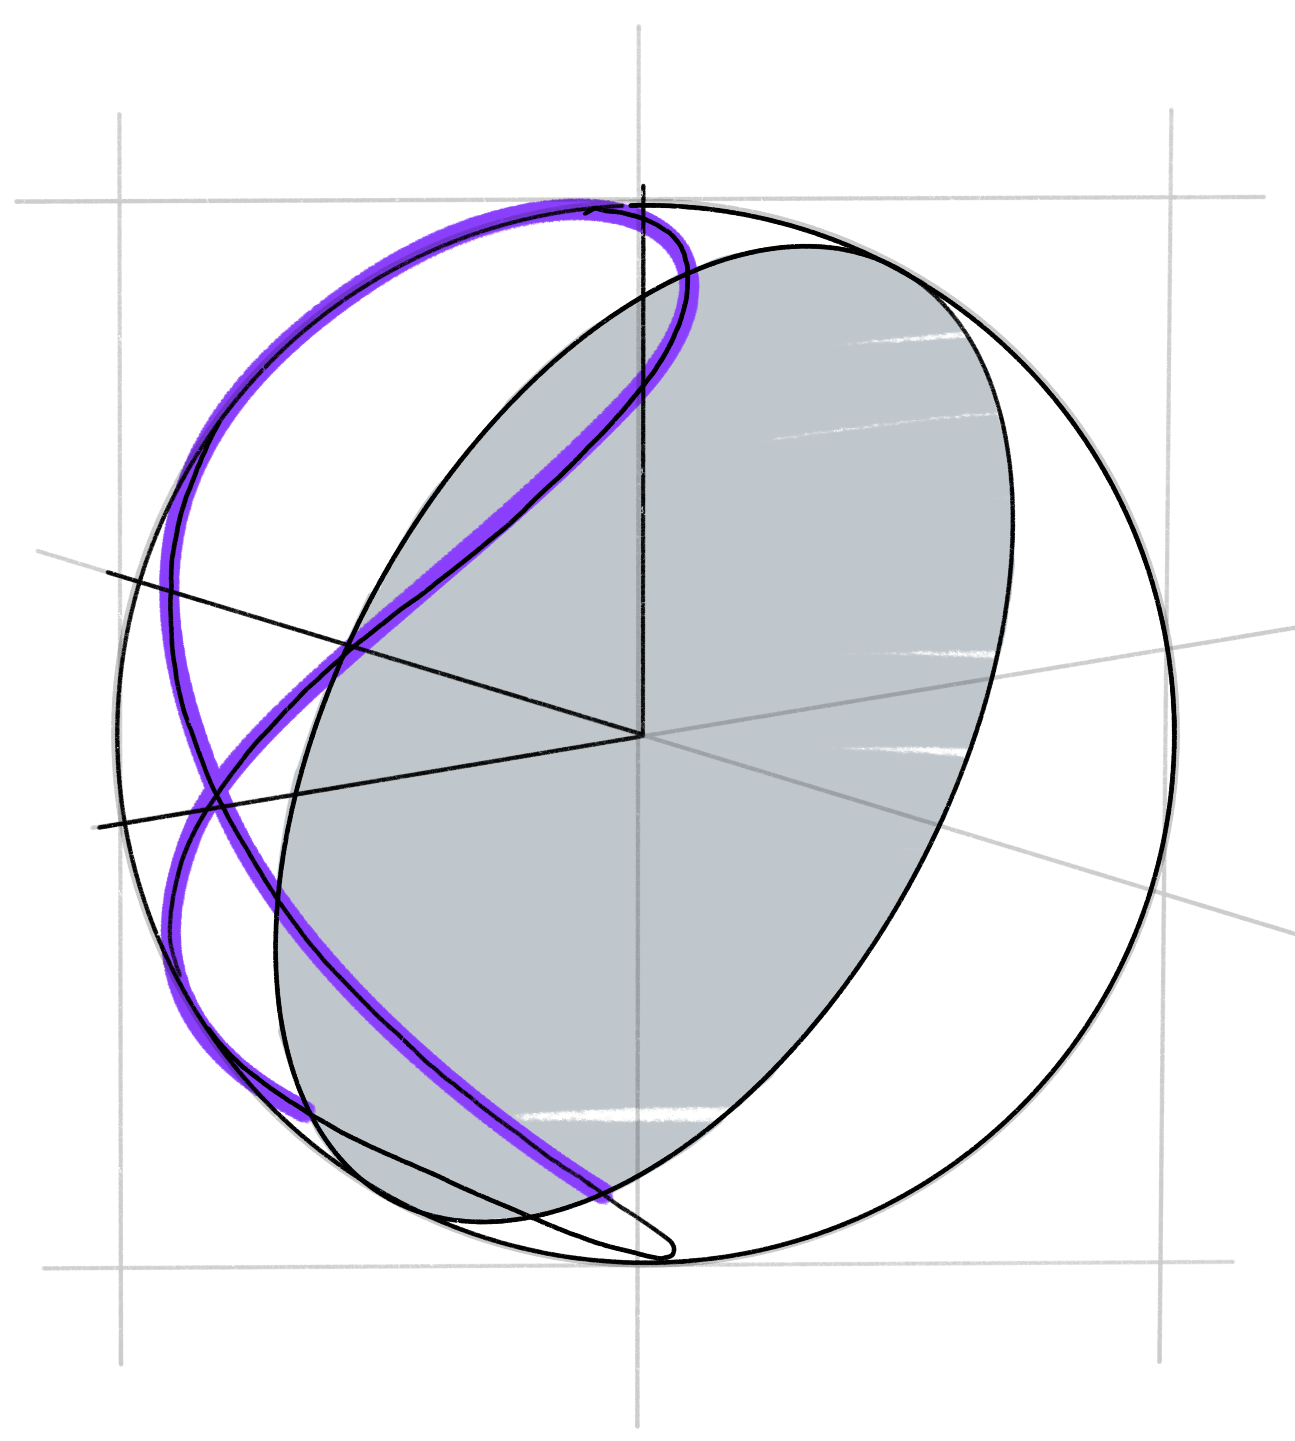
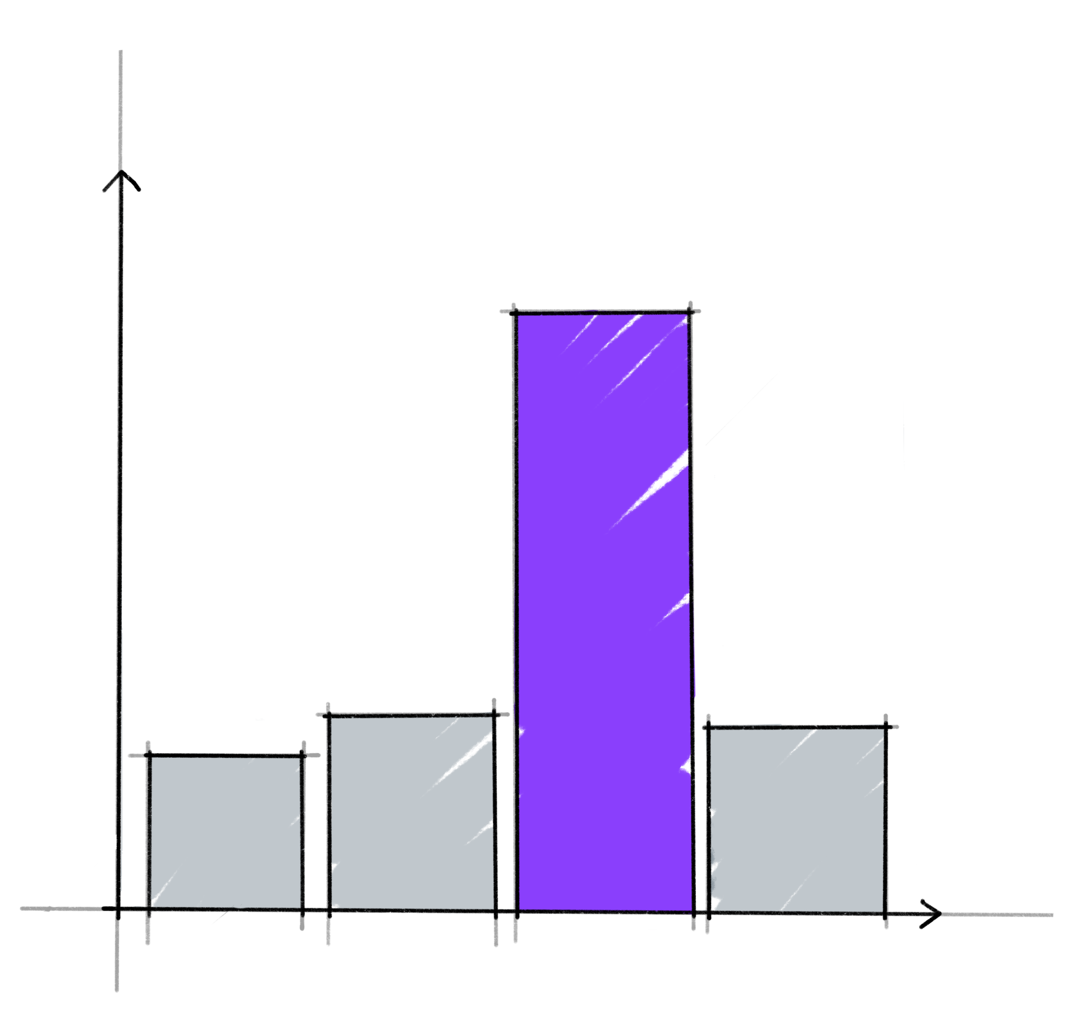
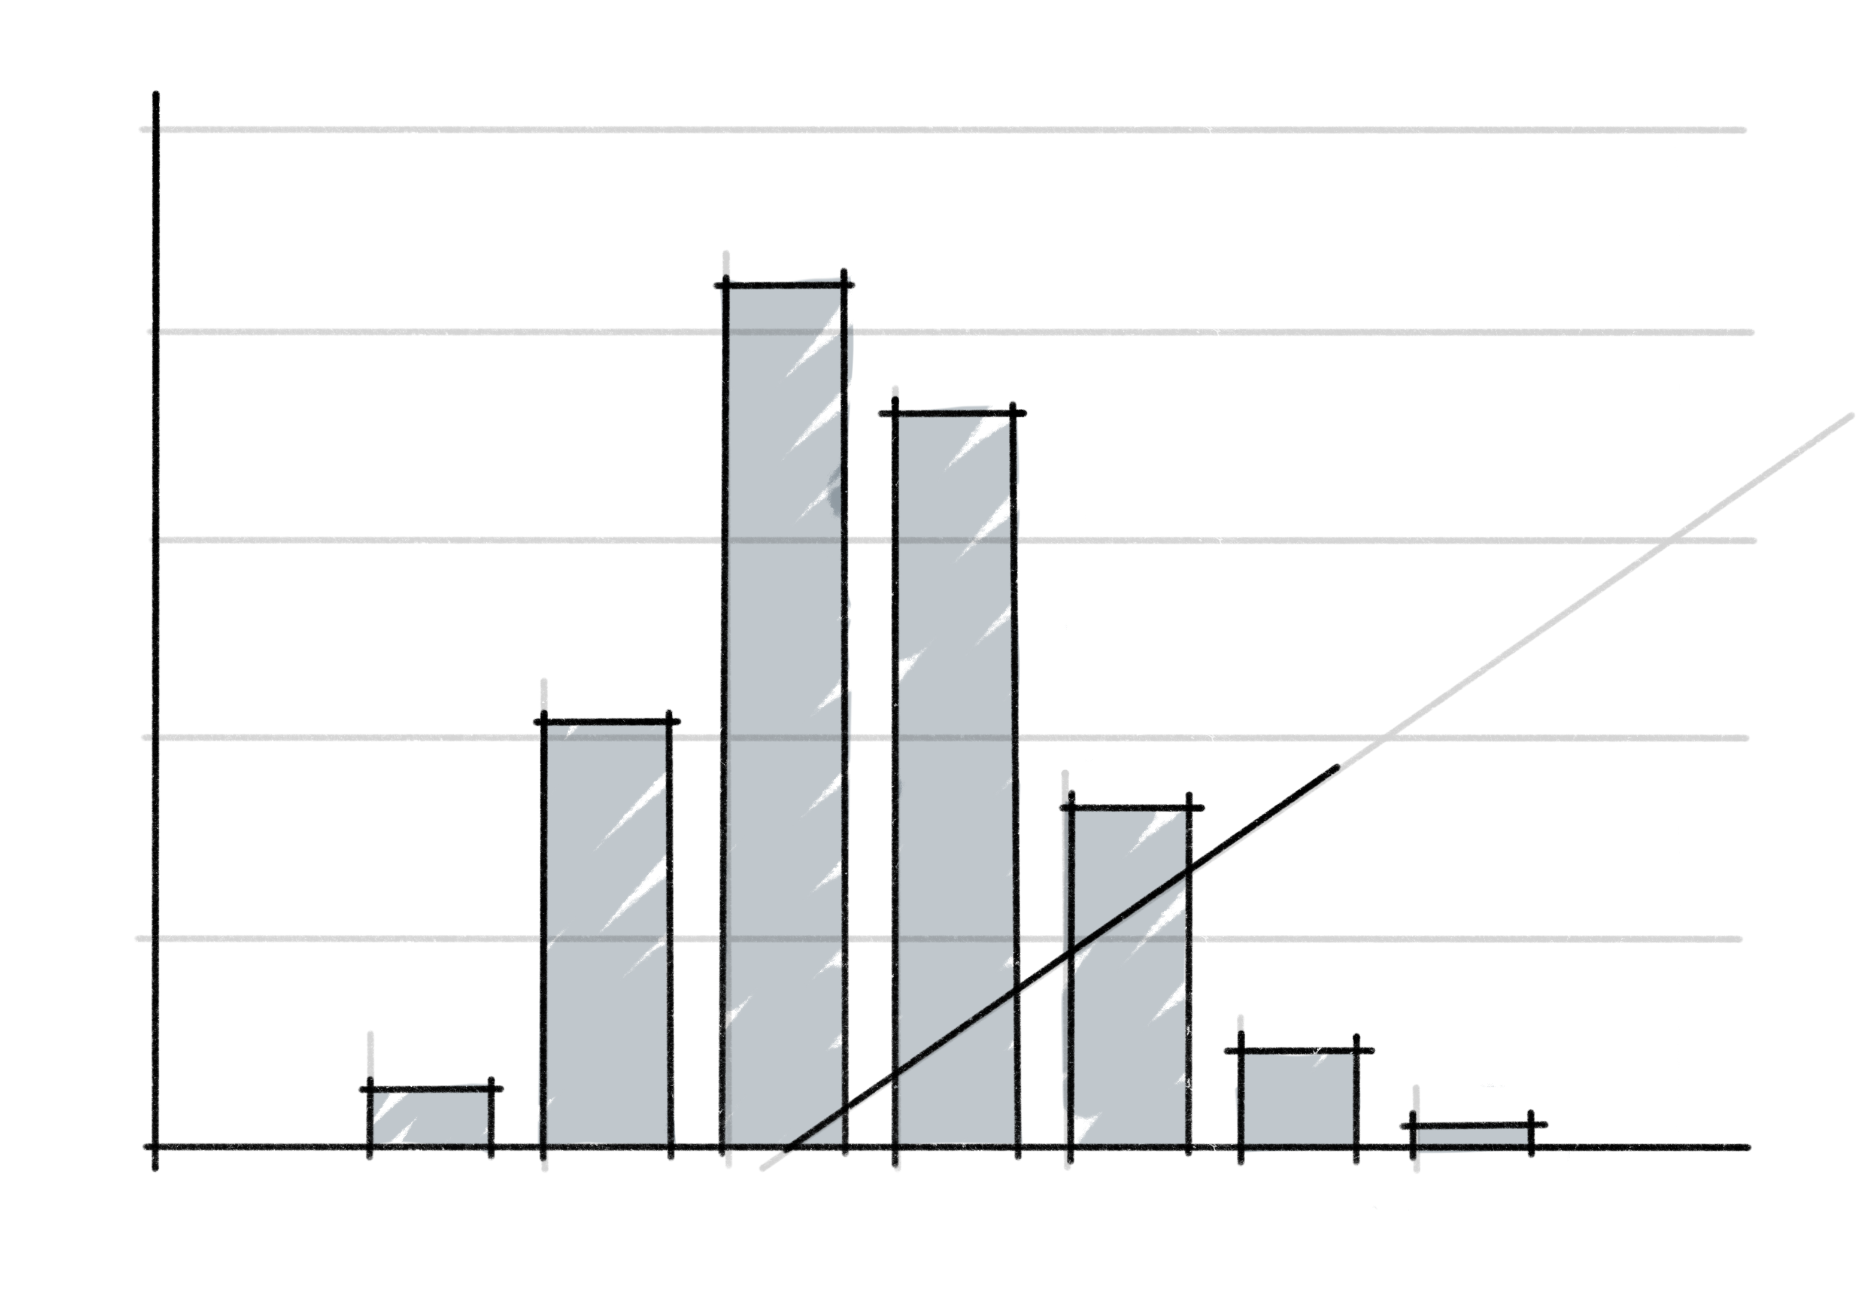
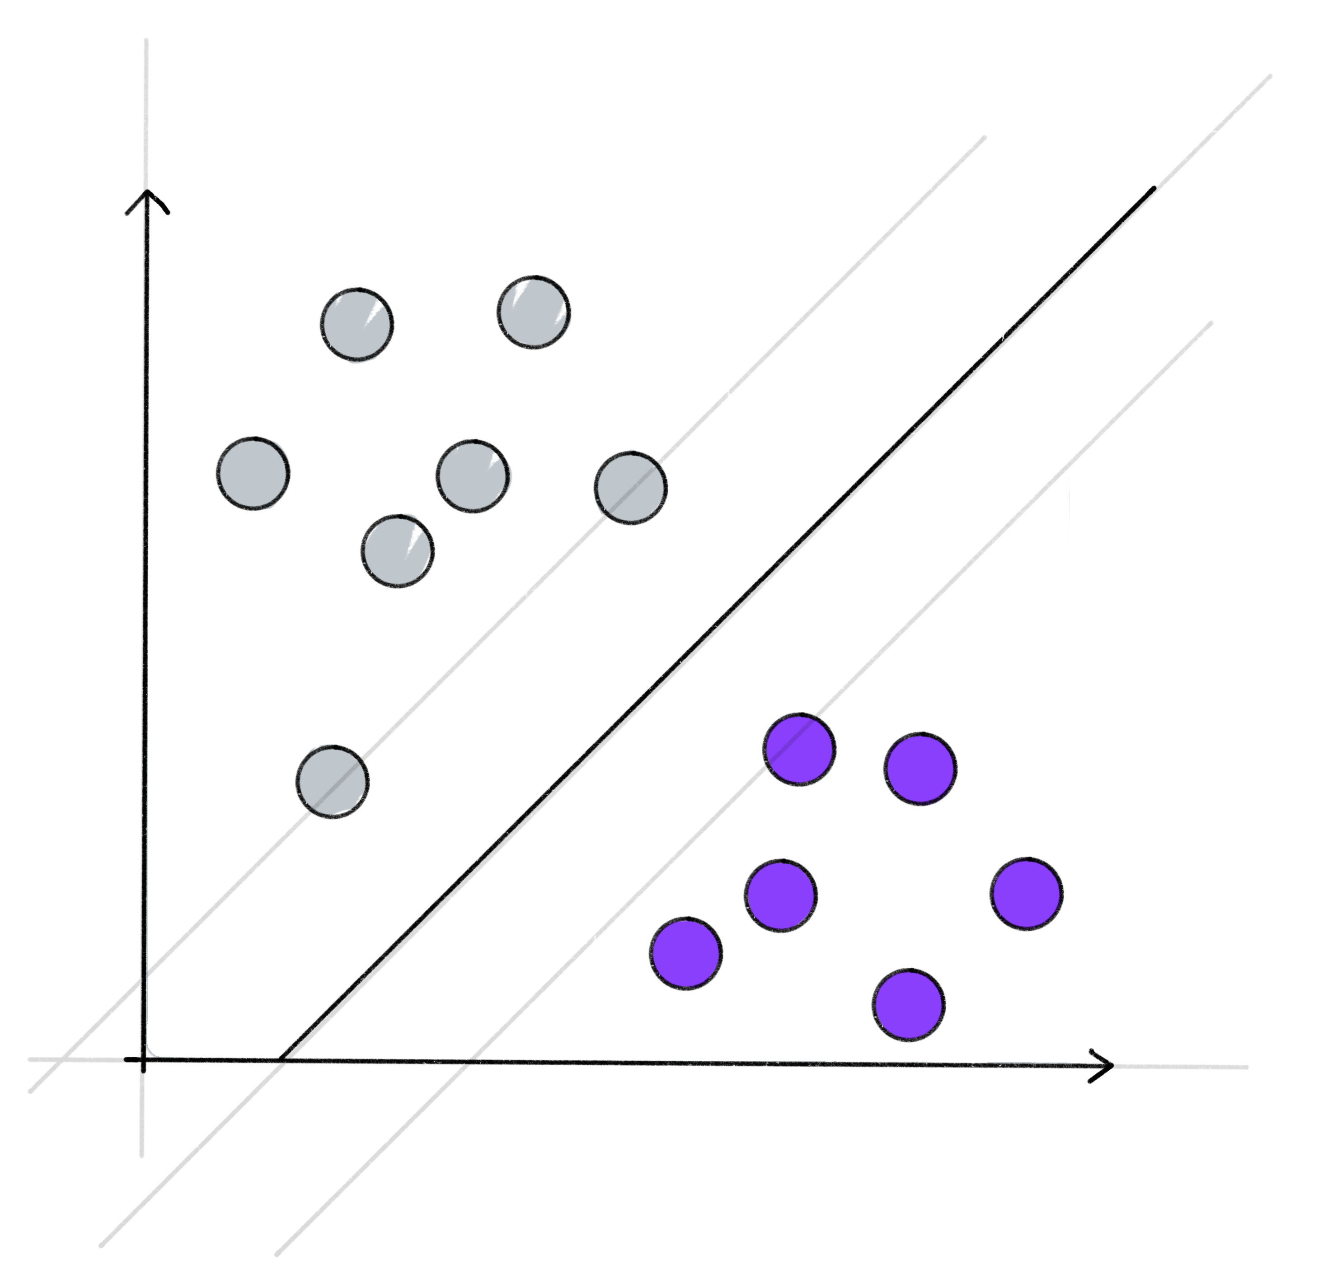
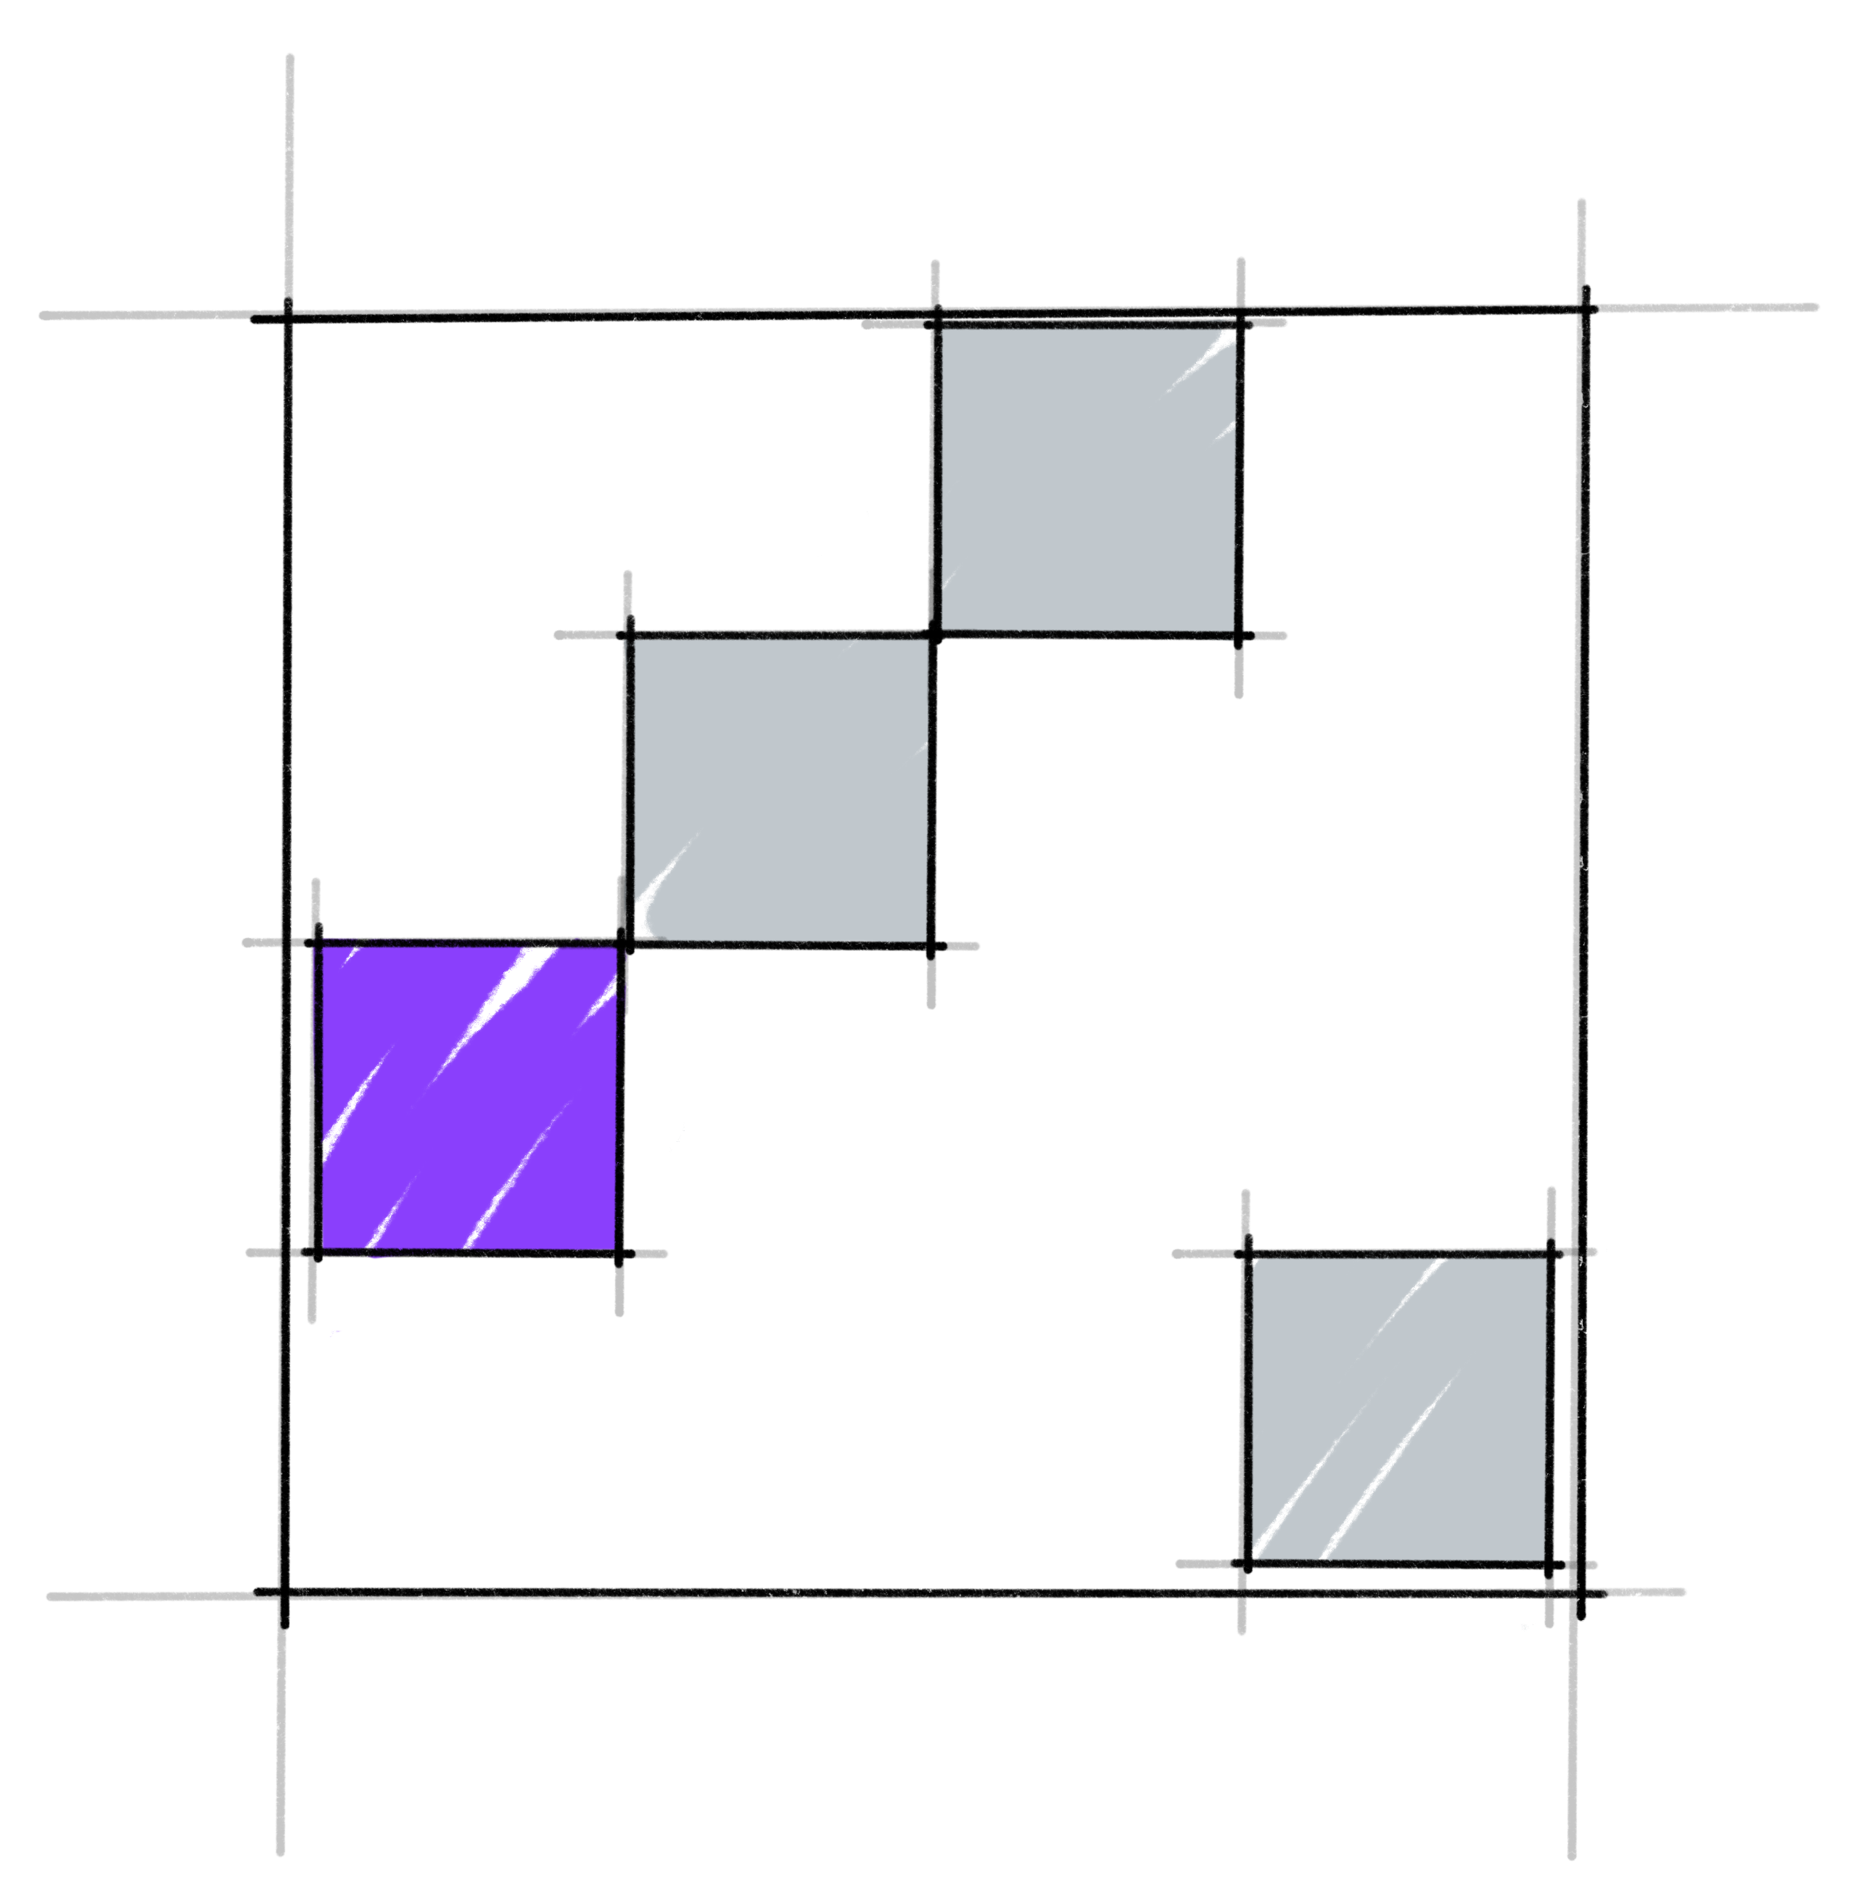
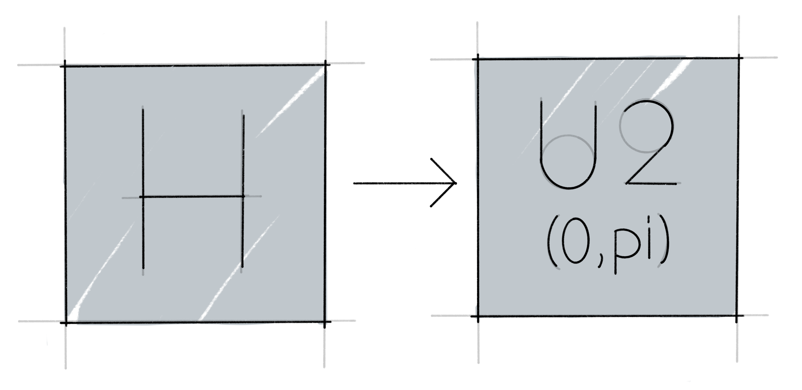
Small images 2
Calibration visualization
Machine Learning visualization
Finance visualization
Grover visualization
QSVM visualization
Verification visualization
Transpiler visualization

